Slide 1
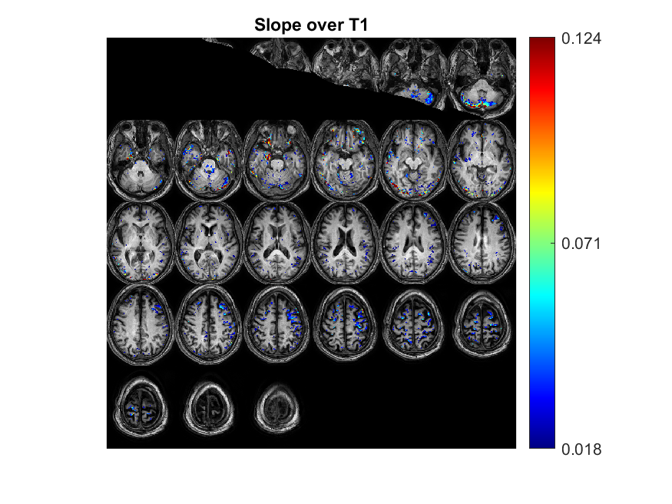
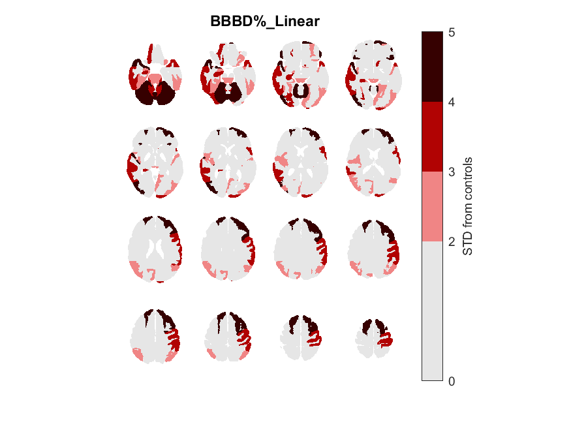
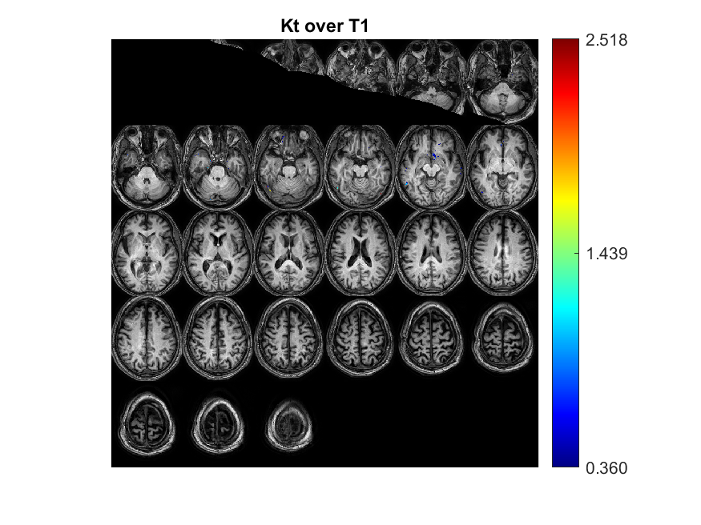
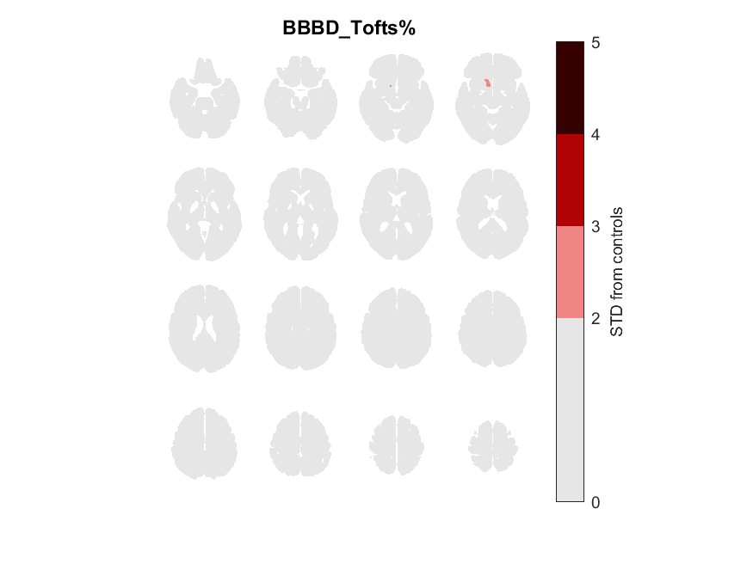
BJ_8378
Focal/General | Focal Type | 'age' | 'gender' | 'Epilepsy type' | 'Seizures type' | 'Medications' | Depalept | Tegretol | Keppra | Lamictal | Family History | Age of oneset | Year of epilepsy | Sizure Frequency (/m) | Number of medication | Lesion_info | Lesion_info_en | Lesion | EEG_findings | EEG | Data source | Clinical files exist | EEG files exist
G |  | 67 | 'M' | 'GTCE' | 'GTCS' | 'Valproic acid' | 0 | 0 | 0 | 0 |  | 12 | 55 | 0 | 0 | 2 מוקדי המוסידרין באונה אוקסיפיטאלית ופריאטאלית משמאל | 2 centers in the oxypital and paraphytalic lobe on the left | LO,LP | normal | 0 |  | 1

Slide 2
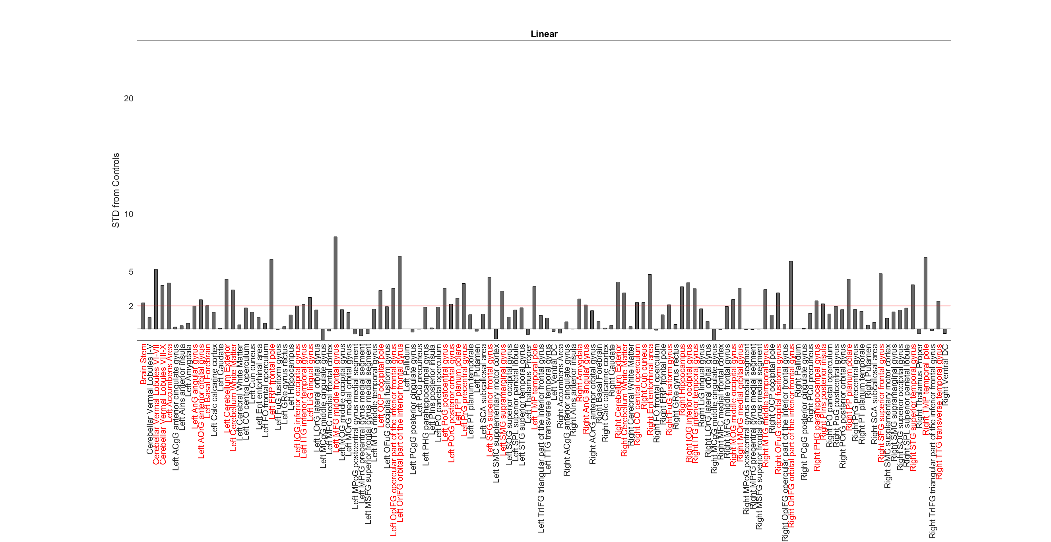
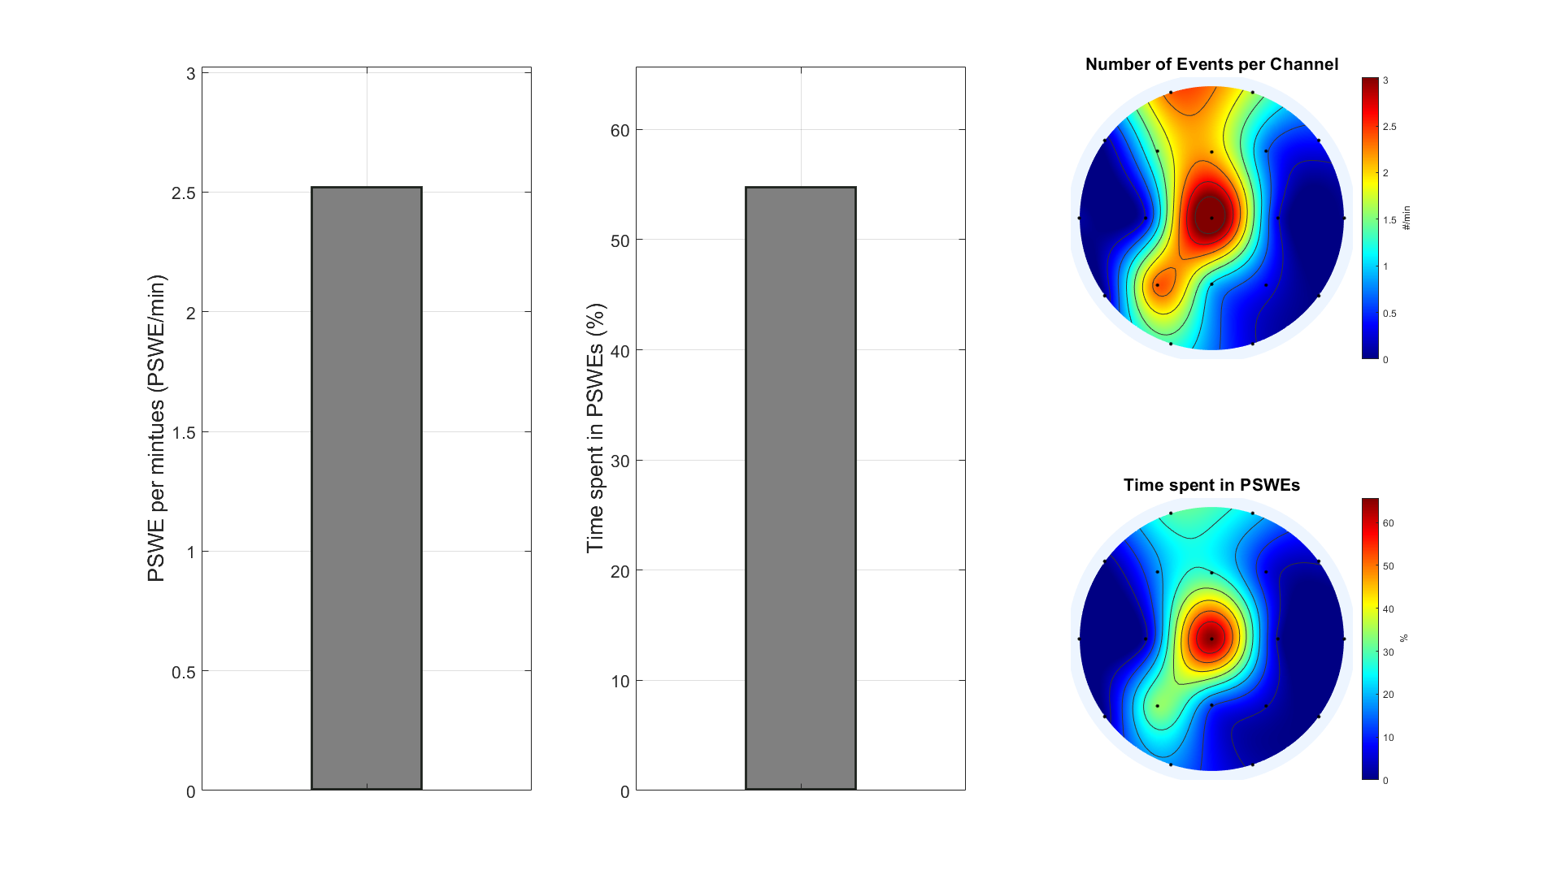
BJ_8378

Slide 3
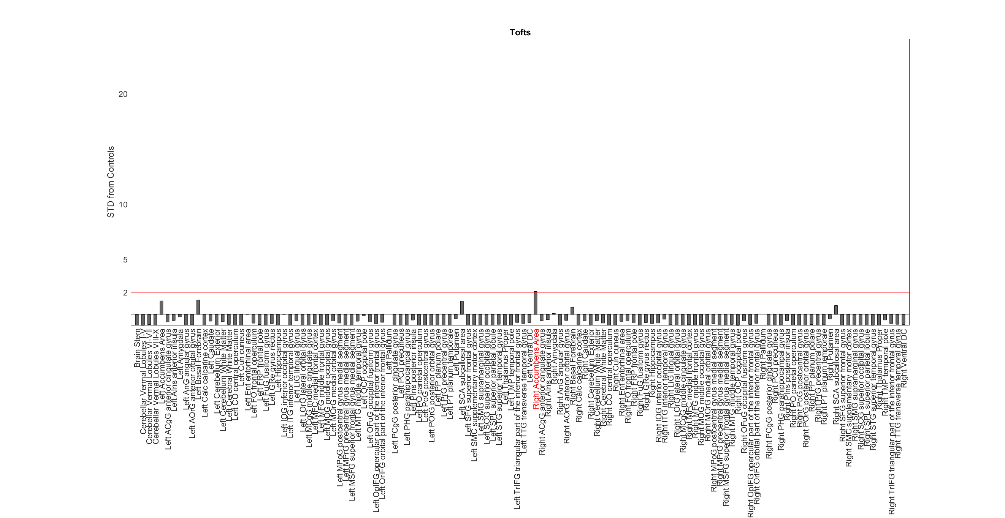
BJ_8378

Slide 4
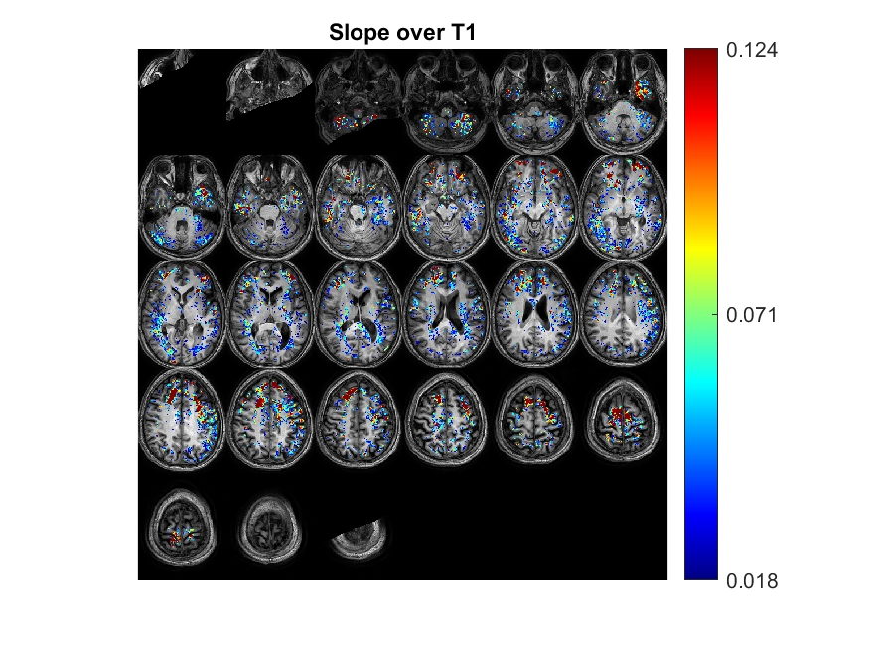
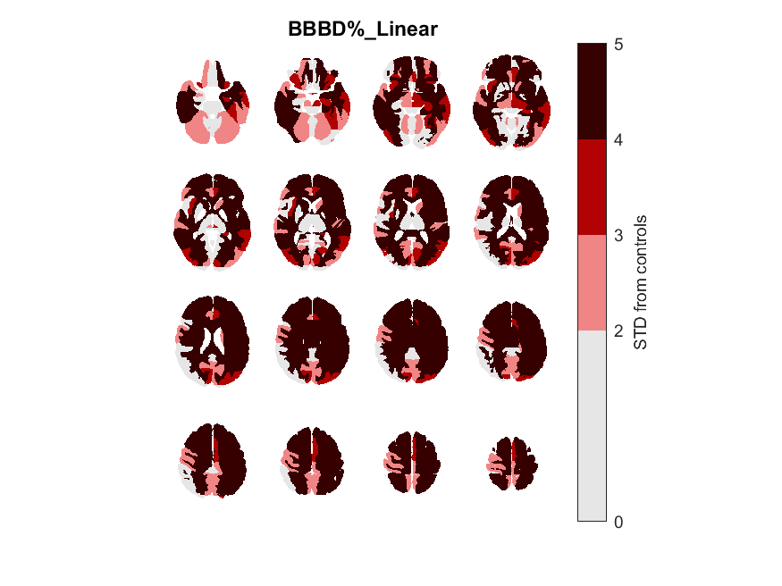
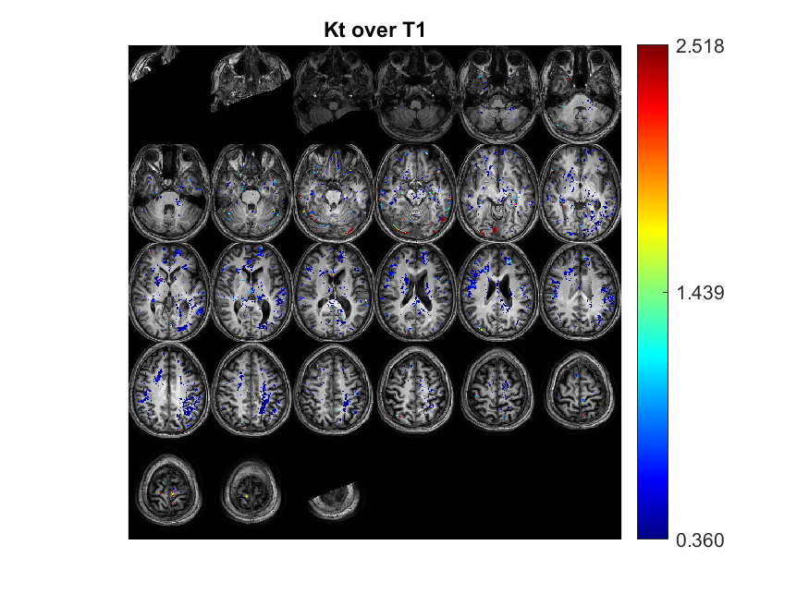
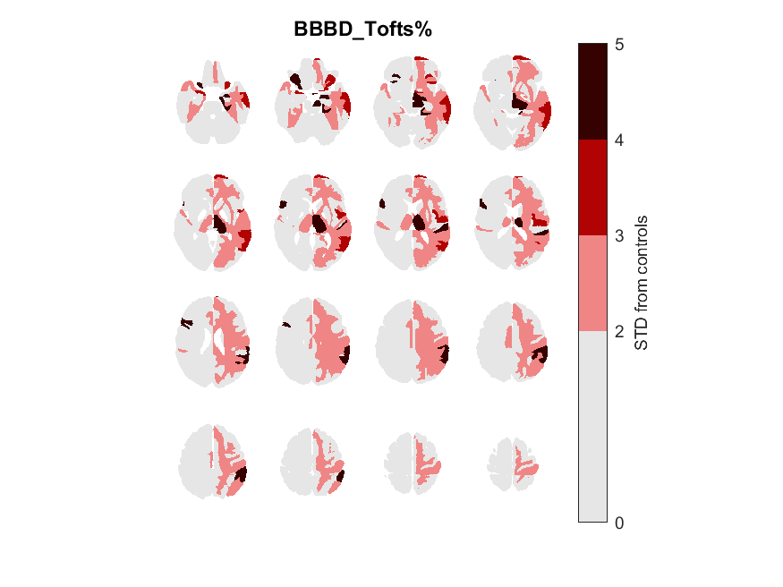
BT_3007
Focal/General | Focal Type | 'age' | 'gender' | 'Epilepsy type' | 'Seizures type' | 'Medications' | Depalept | Tegretol | Keppra | Lamictal | Family History | Age of oneset | Year of epilepsy | Sizure Frequency (/m) | Number of medication | Lesion_info | Lesion_info_en | Lesion | EEG_findings | EEG | Data source | Clinical files exist | EEG files exist
G |  | 33 | 'M' | 'Seizure(7803)' | 'אפילפסיה קשה מגיל ילדות (4) Frontal lode epilepsy with nocturnal complex partial seizures' | 'Tegretol 400mg 2/D Depalept CR 750mg 1/D ' | 1 | 1 | 0 | 0 | 1 | 4 | 29 | 0.5 | 2 | קורטיקלית משמאל precentral gyrus חוסר סדירות ככל הנראה focal cortical dysplasia מתמשך ל-INFERIOR FRONTAL LEFT GYRUS | Cortical on the left precentral gyrus irregularity probably Focal Cortical Dysplasia continues to Inferior Frontal Left Gyrus | LF | 0 |  |  | 1

Slide 5
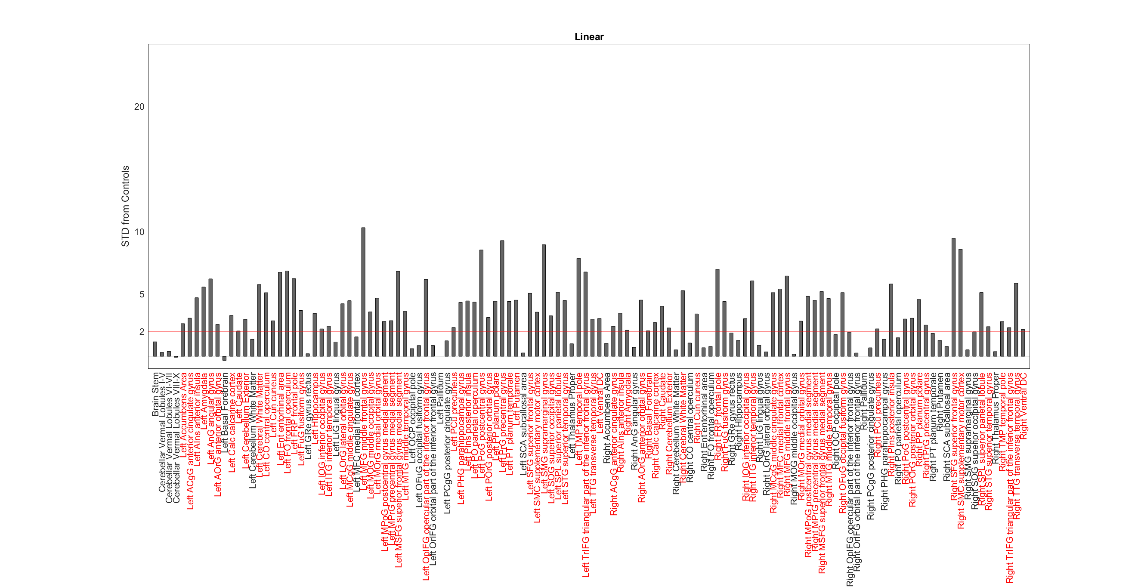
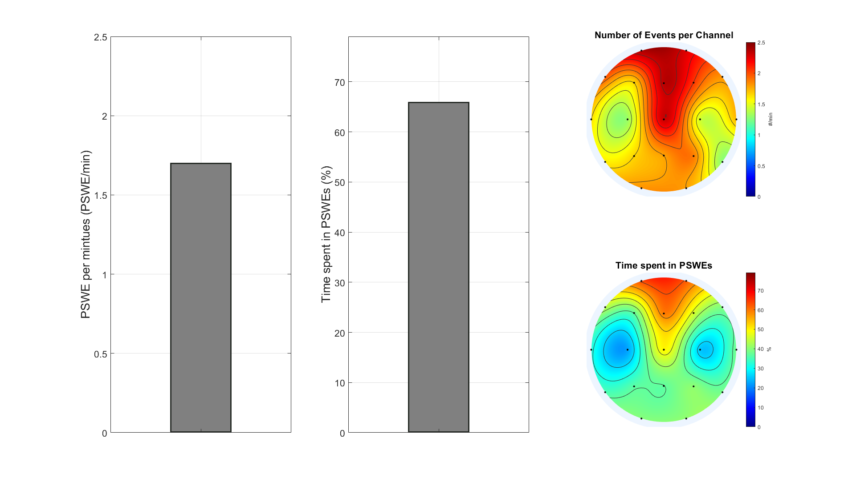
BT_3007

Slide 6
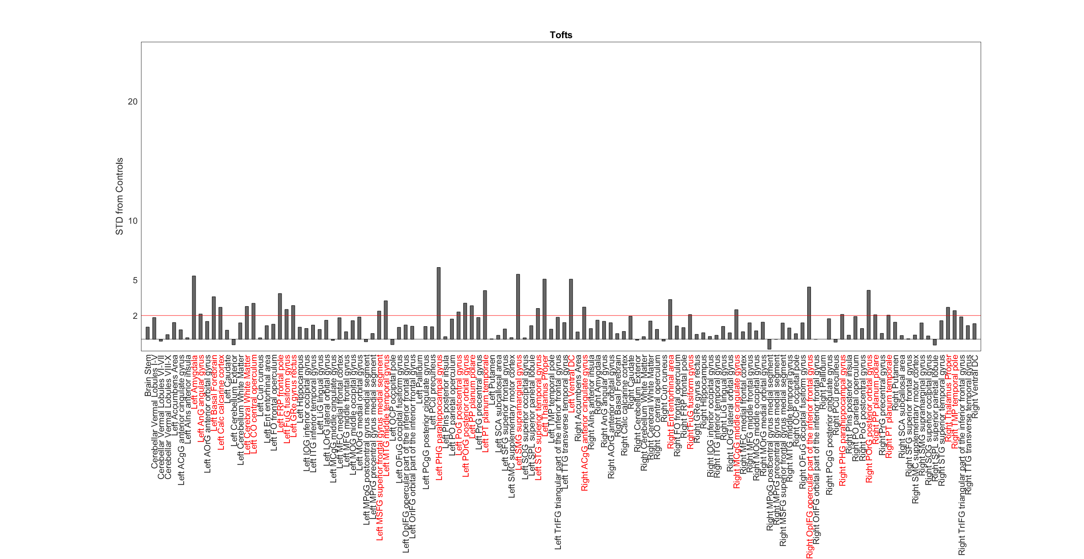
BT_3007

Slide 7
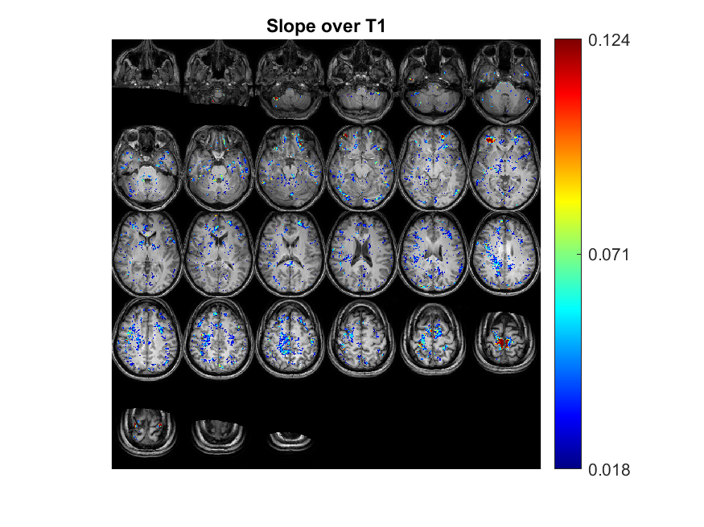
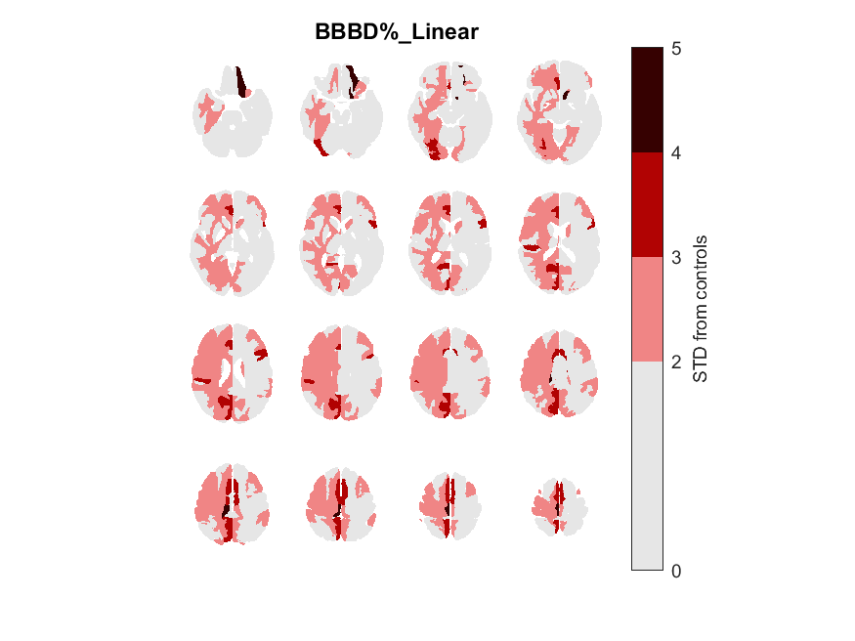
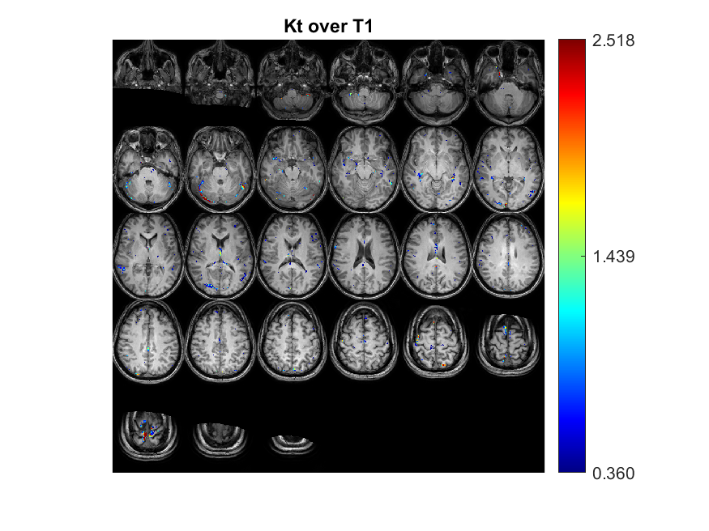

CH_1474
Focal/General | Focal Type | 'age' | 'gender' | 'Epilepsy type' | 'Seizures type' | 'Medications' | Depalept | Tegretol | Keppra | Lamictal | Family History | Age of oneset | Year of epilepsy | Sizure Frequency (/m) | Number of medication | Lesion_info | Lesion_info_en | Lesion | EEG_findings | EEG | Data source | Clinical files exist | EEG files exist
G |  | 35 | 'F' | Myoclonic ' | 'Myoclonus of upper limbs' | 'Valproic acid' | 0 | 0 | 0 | 0 |  | 20 | 15 |  | 0 | מוקדים חומר לבן עמוק וקורטיקלי superior frontal right . | Mukdim's graphic trouble eluk Ukurtically superior Frontal right. | RF | frontal beta and back alpha 9/s. temporal left - spike and wave T5-> slow | LT |  | 1

Slide 8
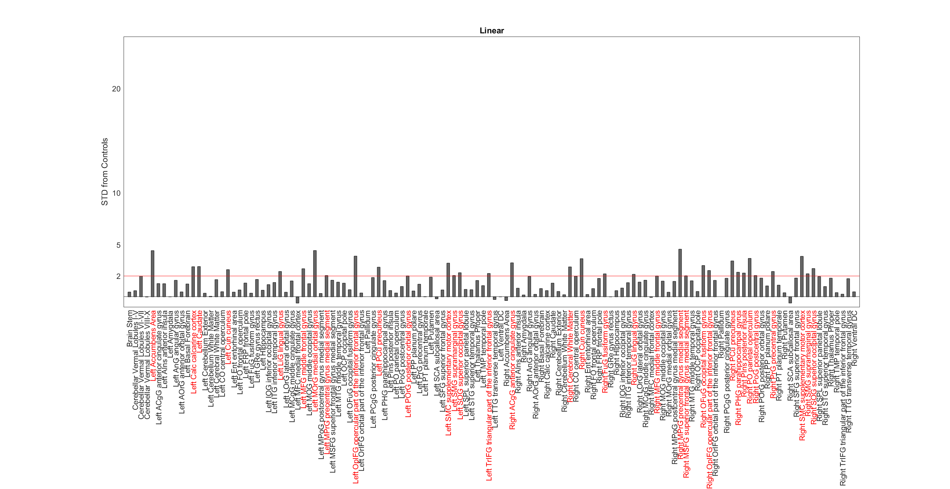
CH_1474

Slide 9
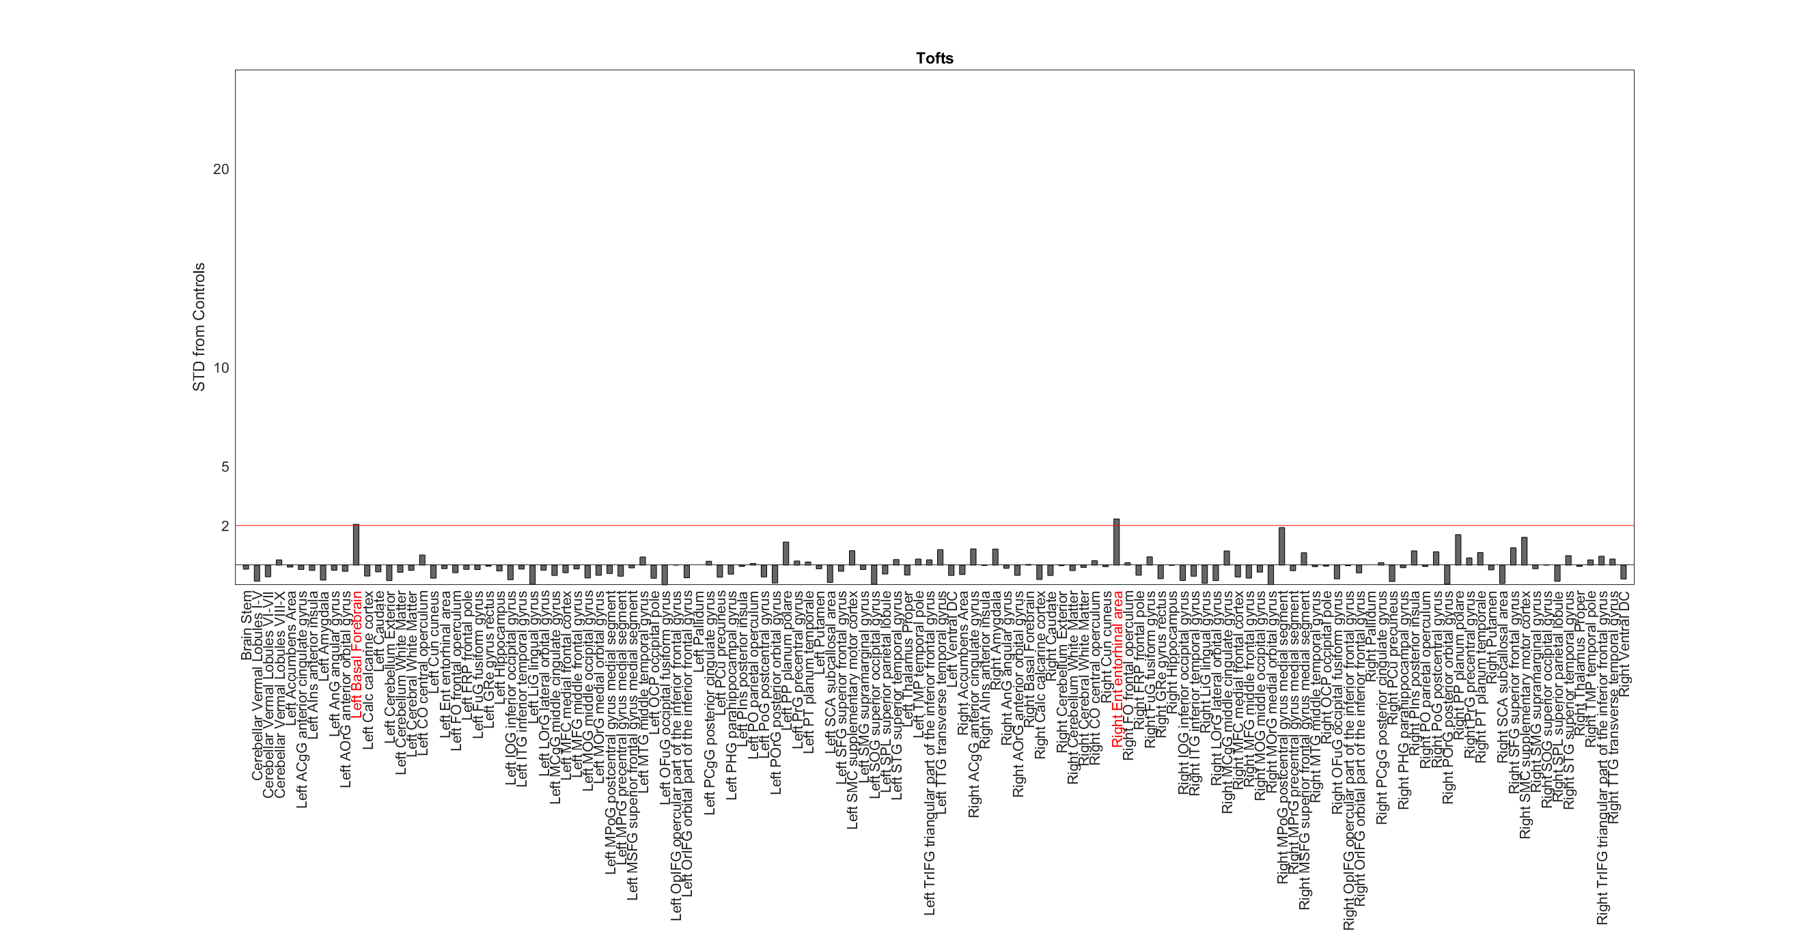
CH_1474

Slide 10
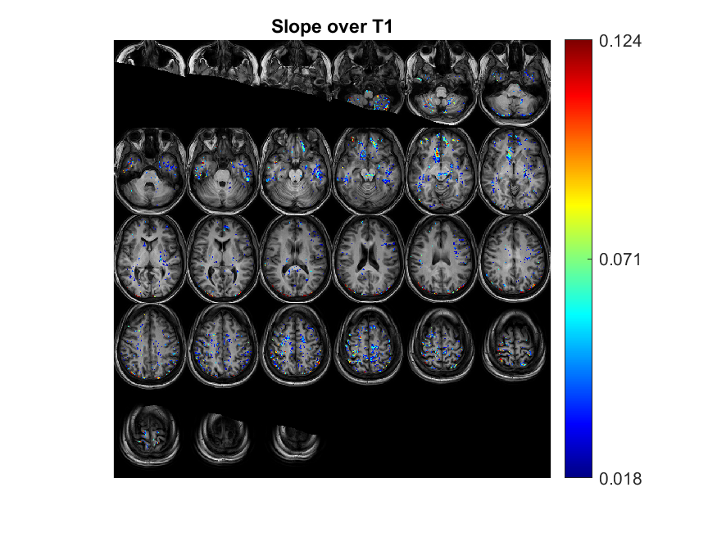
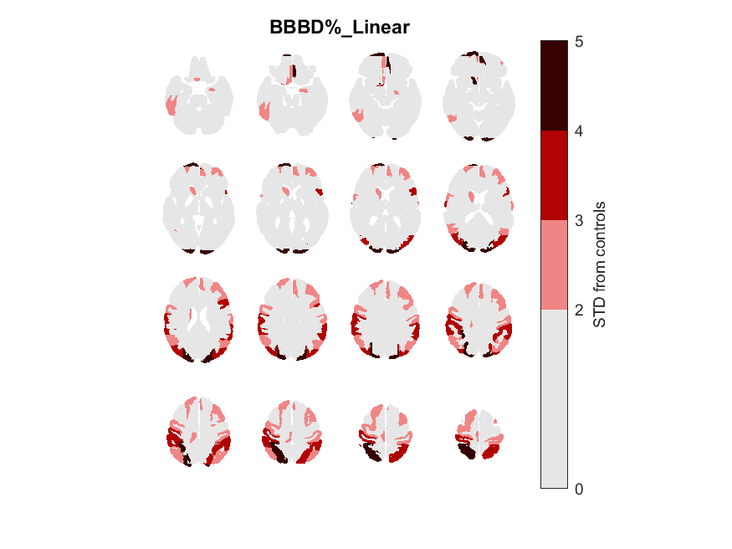
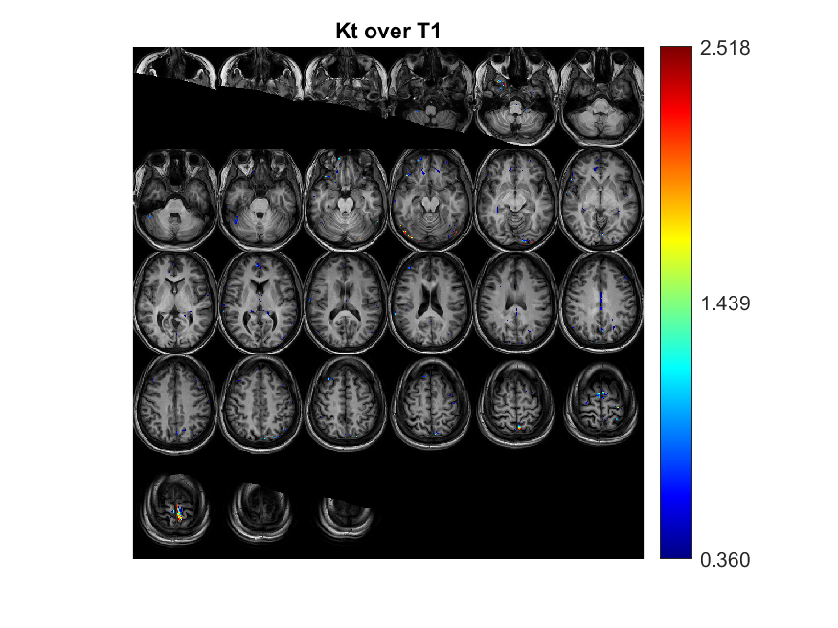
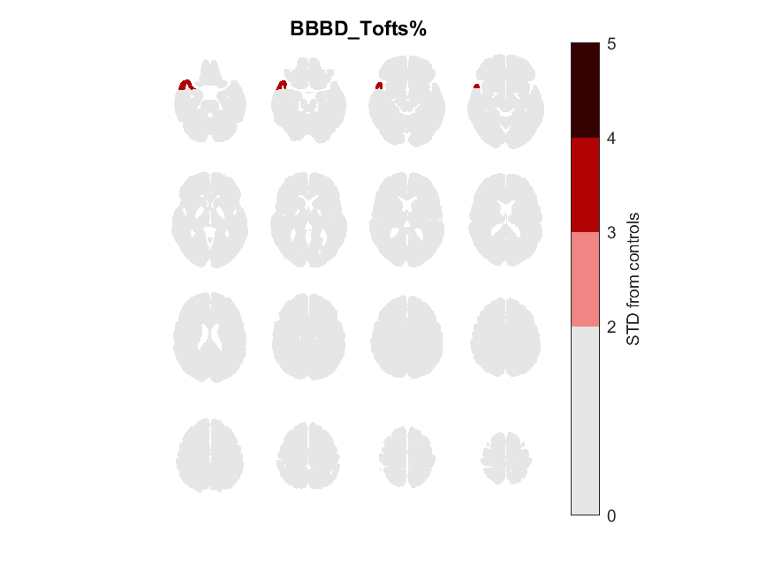
DB_5862
Focal/General | Focal Type | 'age' | 'gender' | 'Epilepsy type' | 'Seizures type' | 'Medications' | Depalept | Tegretol | Keppra | Lamictal | Family History | Age of oneset | Year of epilepsy | Sizure Frequency (/m) | Number of medication | Lesion_info | Lesion_info_en | Lesion | EEG_findings | EEG | Data source | Clinical files exist | EEG files exist
F | O | 32 | F' | 'interictal spikes Rt temporal Lt.occiptal' | 'GTCS' | lamictal, keppra | 0 | 0 | 1 | 1 | 1 | 17 | 15 |  | 2 | רושם להיפוקמפוס קטן יותר מימין | Impression is smaller to the right | RT | התקף ממקור צנטרוטמפורלי מימין, פעילות אינטראיקטלית והאטה אינטרמיננטית וטמפורלית ימנית | RT | וולפסון, מרפאה נוירולוגית 26.04.2018 | 1

Slide 11
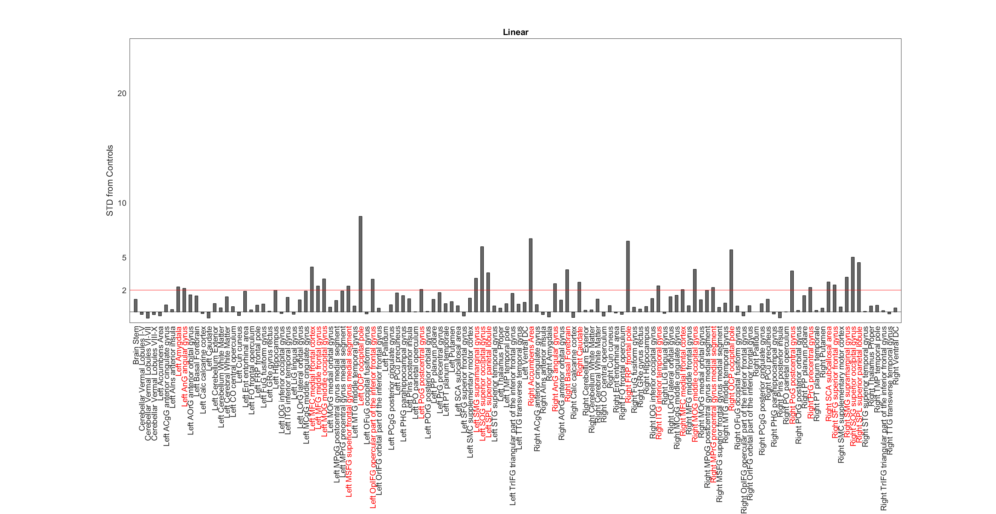
DB_5862

Slide 12
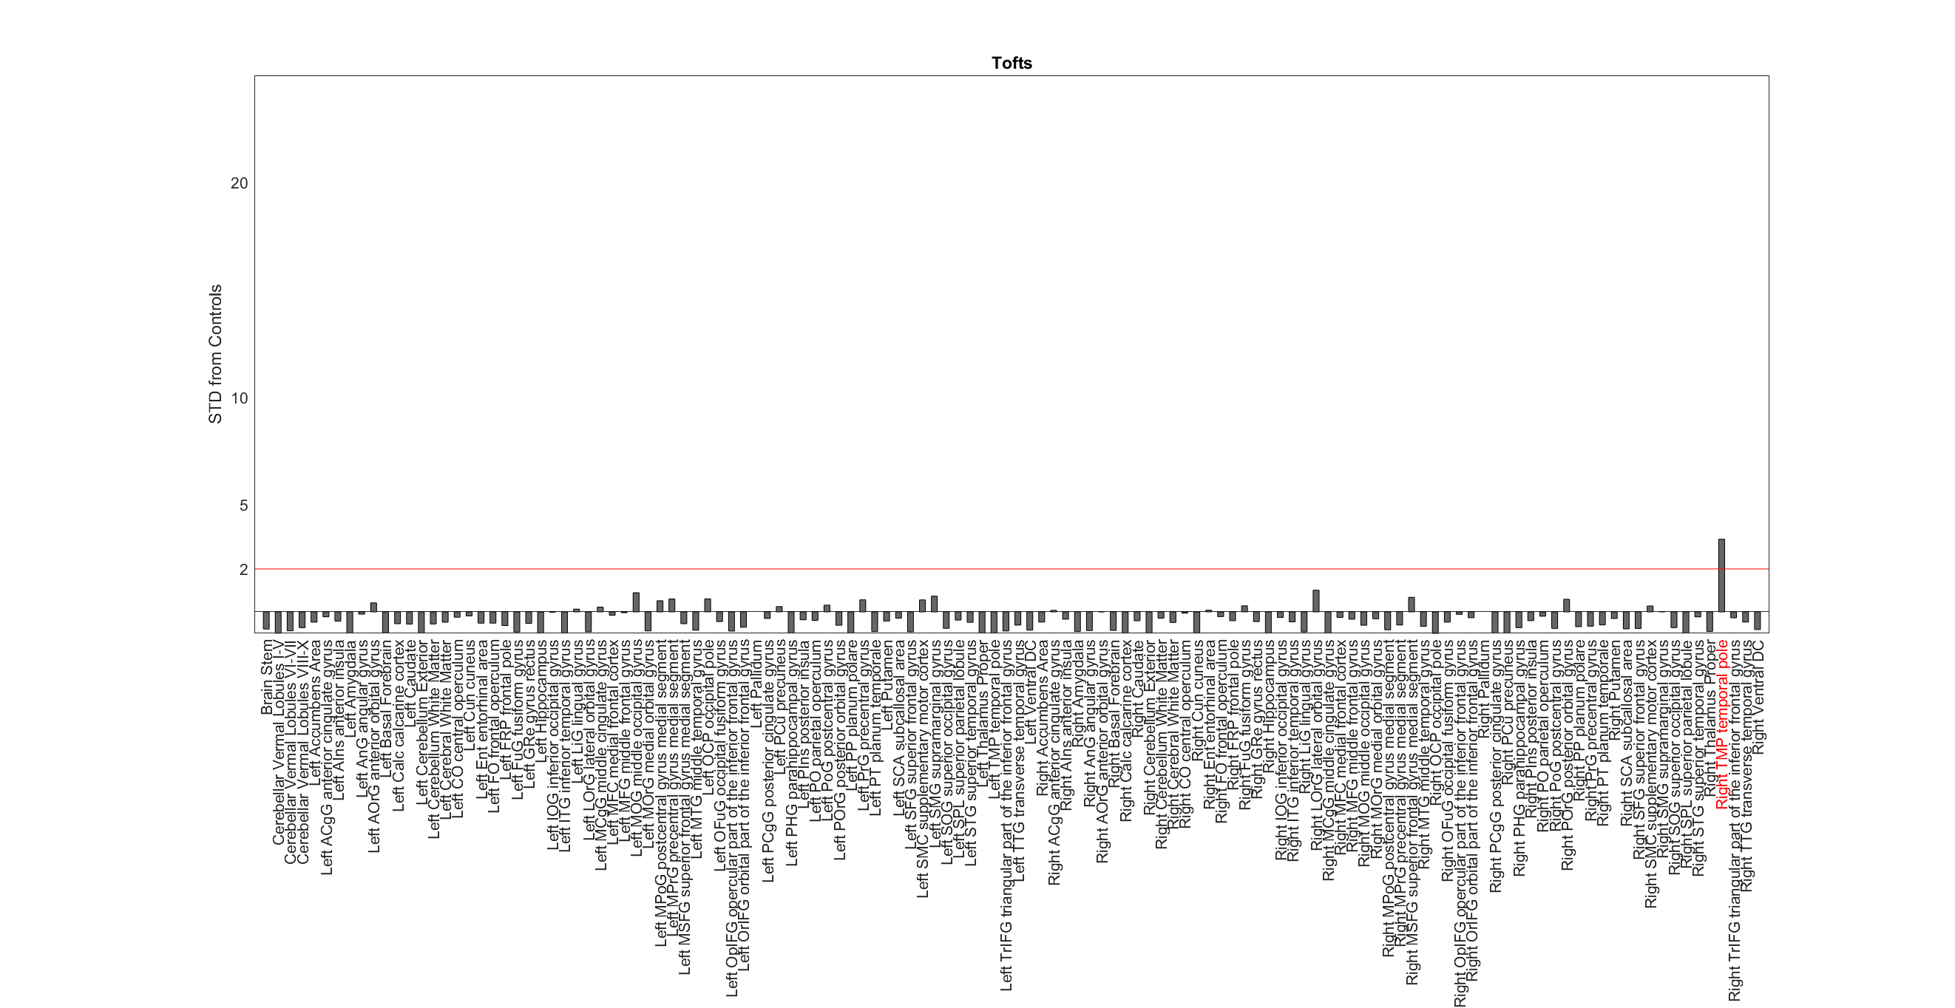
DB_5862

Slide 13
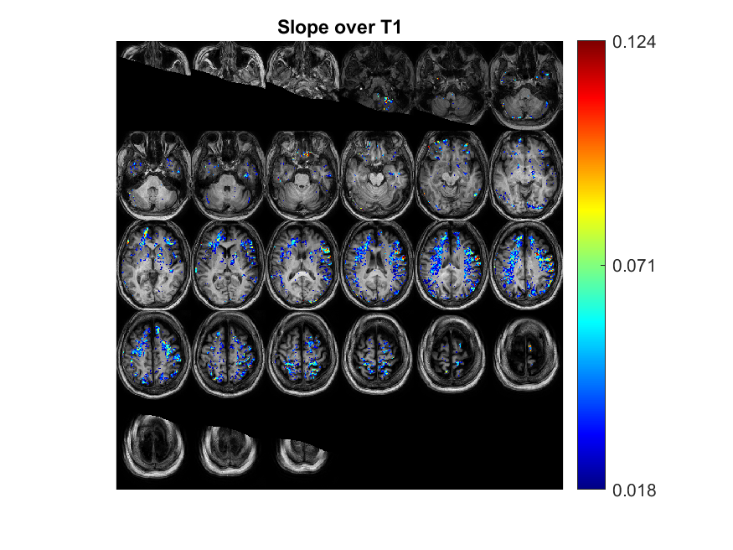
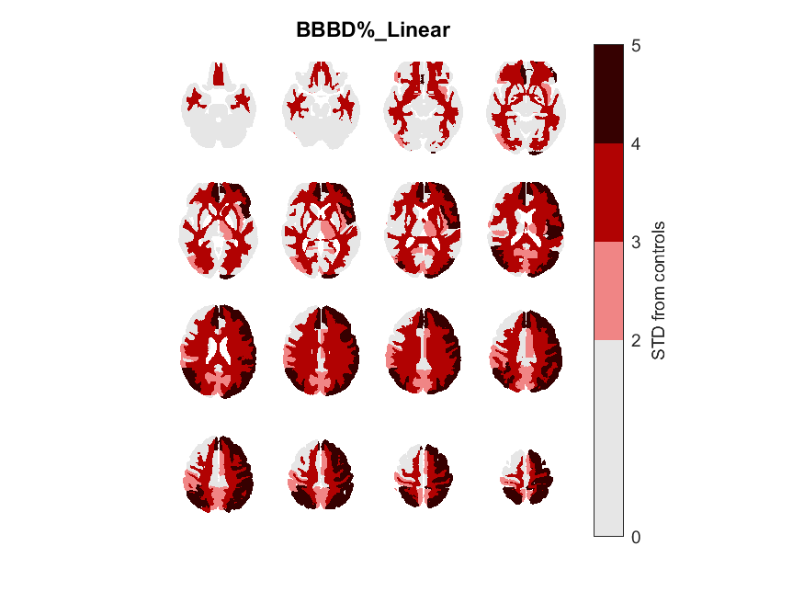
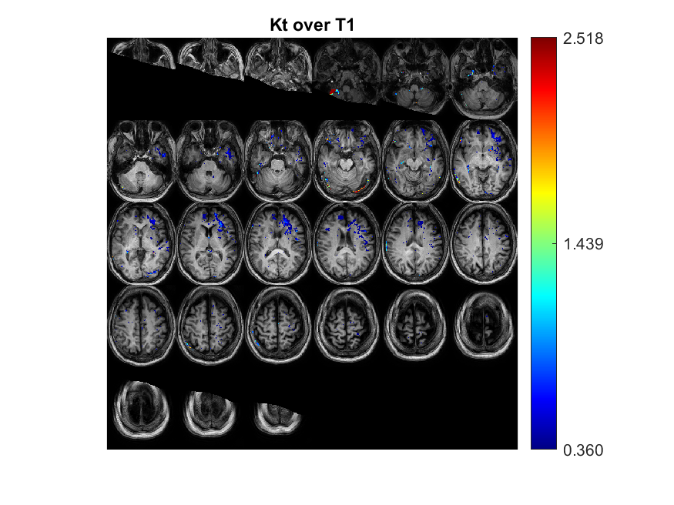
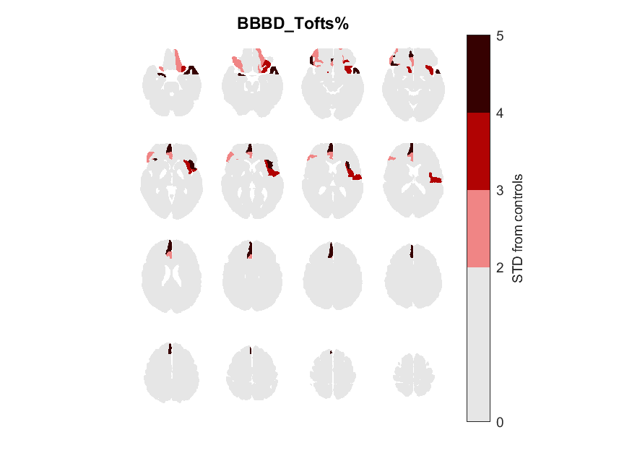
EA_0804
Focal/General | Focal Type | 'age' | 'gender' | 'Epilepsy type' | 'Seizures type' | 'Medications' | Depalept | Tegretol | Keppra | Lamictal | Family History | Age of oneset | Year of epilepsy | Sizure Frequency (/m) | Number of medication | Lesion_info | Lesion_info_en | Lesion | EEG_findings | EEG | Data source | Clinical files exist | EEG files exist
F | T | 57 | 'F' | 'Letf fronto-temporal EEG activity' | 'absence' | Tegretol',Keppra | 0 | 1 | 1 | 0 |  | 21 | 36 | 1.5 | 2 | אוטם לקונארי ישן בגרעיני הבסיס משמאל, שינויים בלתי ספציפיים בחומר לבן עמוק פרונטלית משמאל Frontal left | Incorporants for old Conseries in the base nuclei on the left, specific changes in deep -frontal white material on the left of Fronal Left | LF | Letf frontal-temporal EEG activity' | LF |  | 1

Slide 14
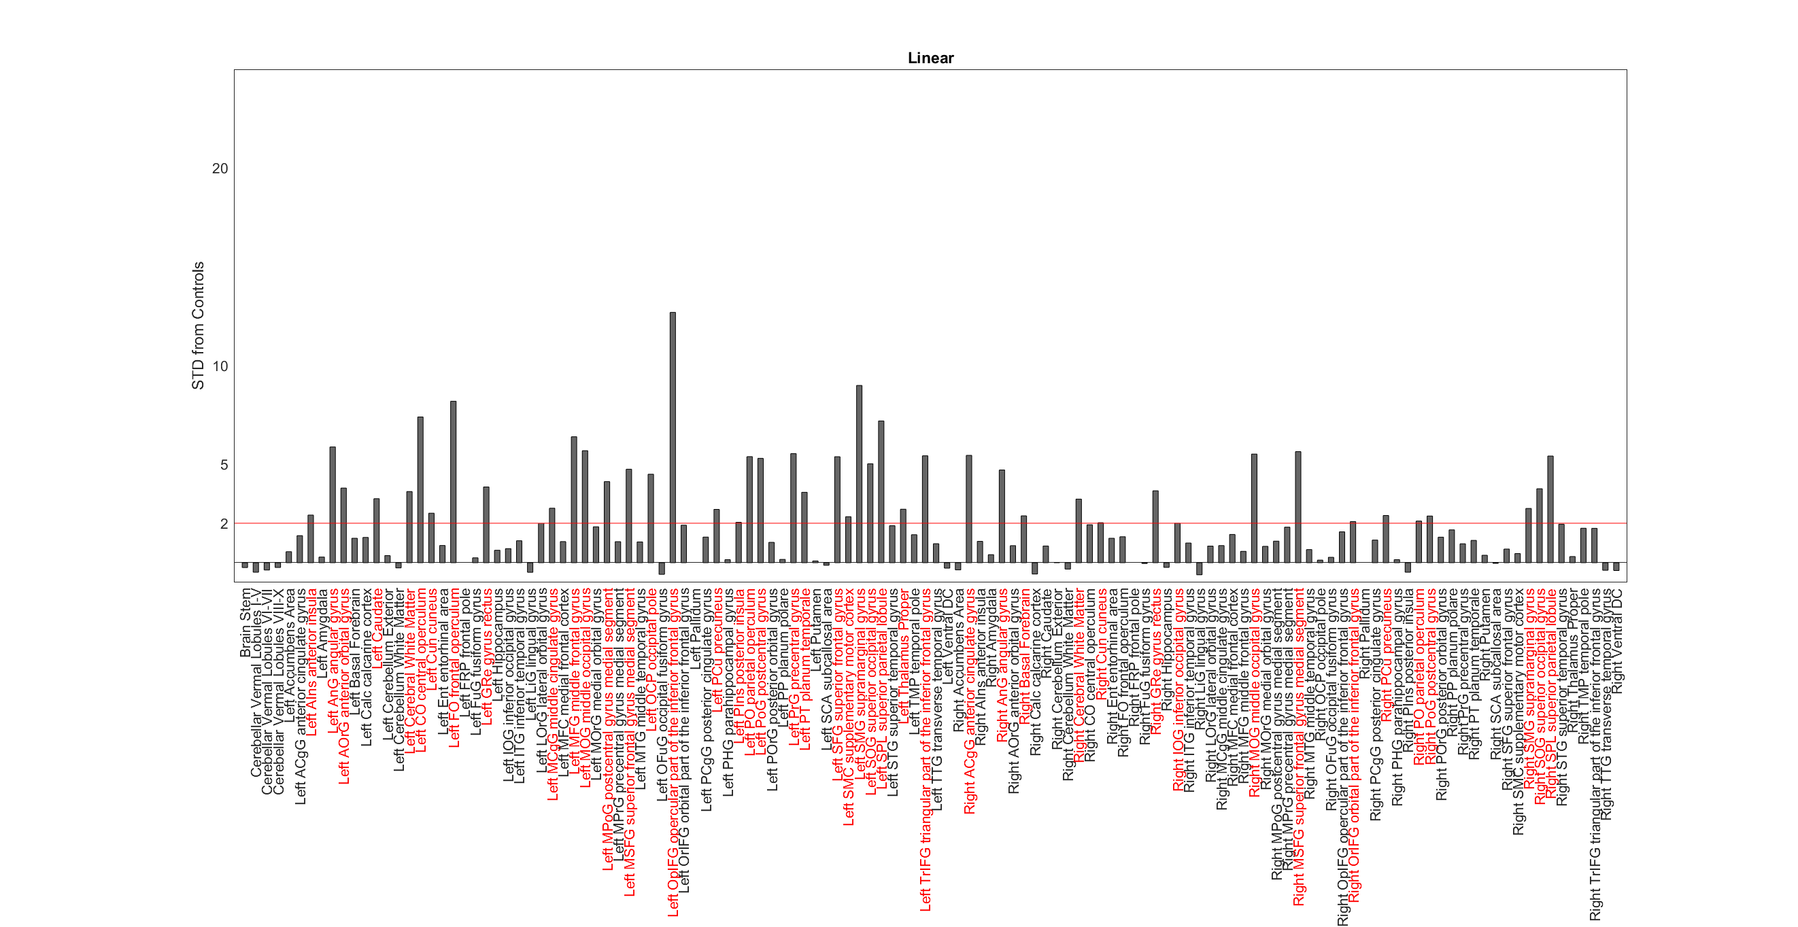
EA_0804

Slide 15
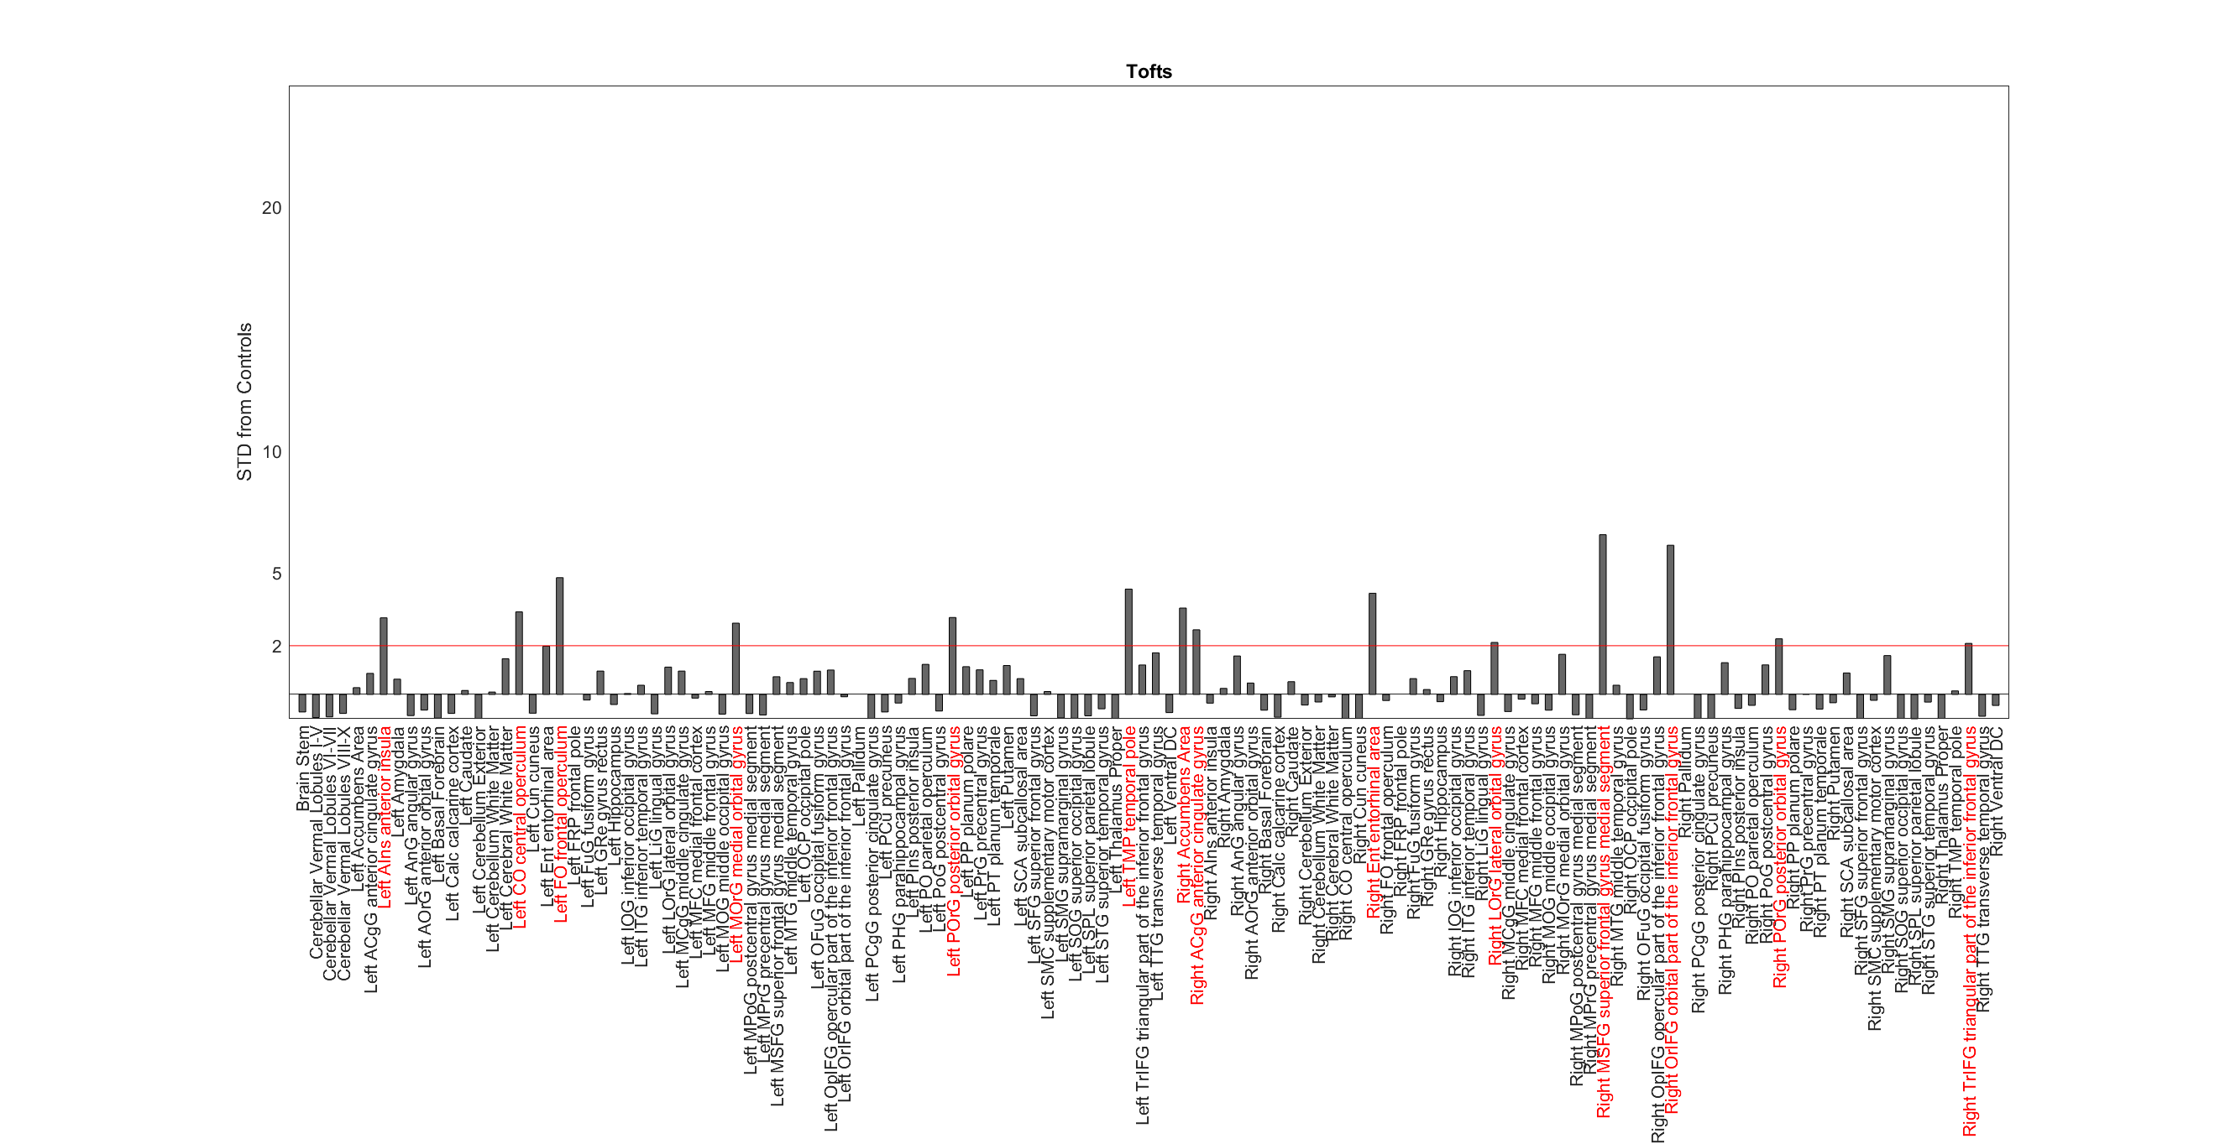
EA_0804

Slide 16
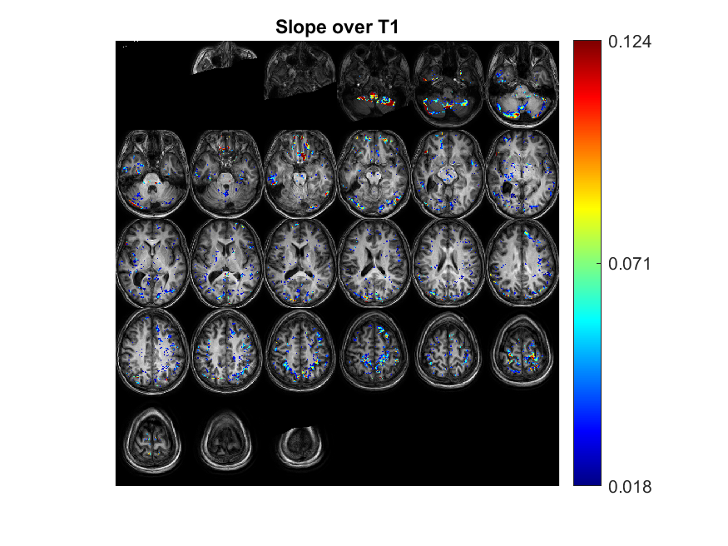
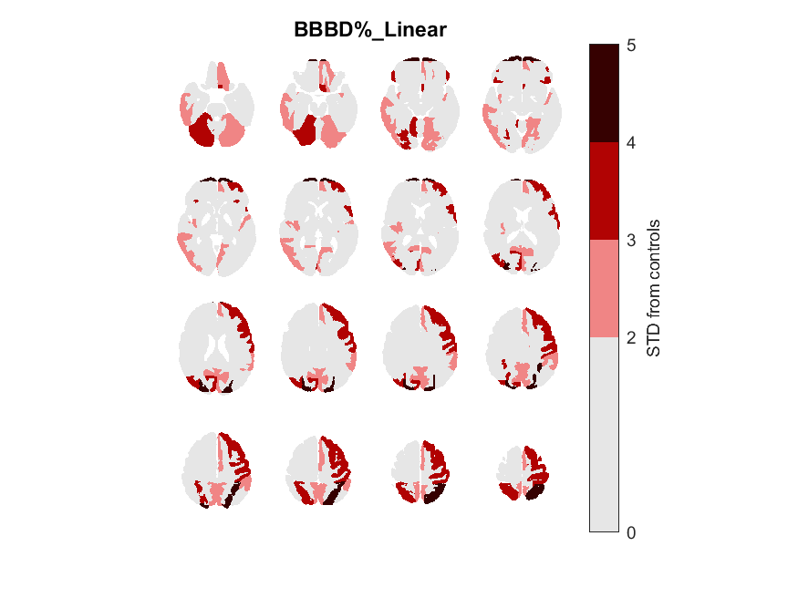
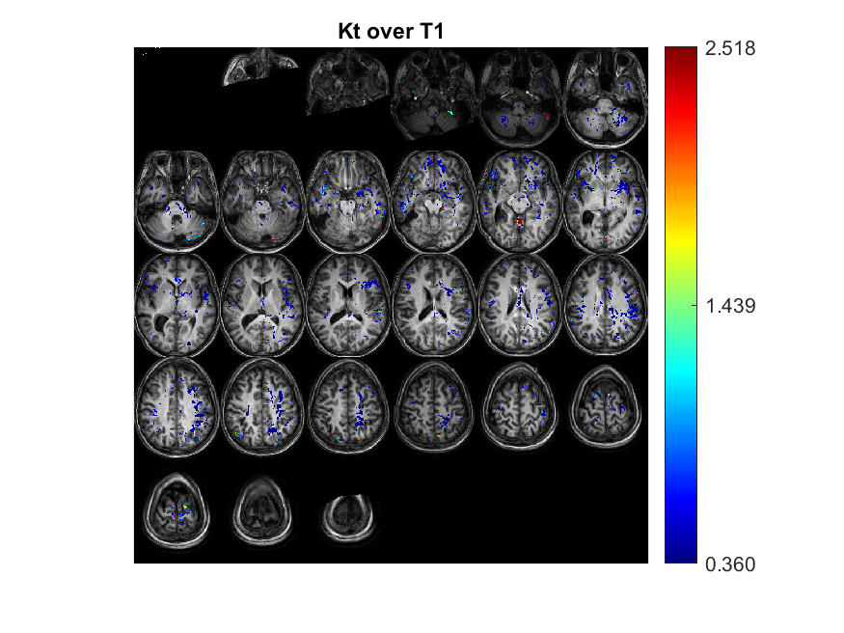
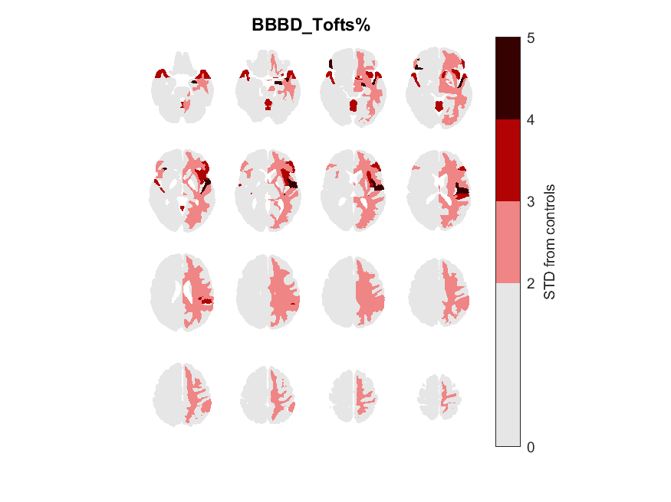
GG_2211
Focal/General | Focal Type | 'age' | 'gender' | 'Epilepsy type' | 'Seizures type' | 'Medications' | Depalept | Tegretol | Keppra | Lamictal | Family History | Age of oneset | Year of epilepsy | Sizure Frequency (/m) | Number of medication | Lesion_info | Lesion_info_en | Lesion | EEG_findings | EEG | Data source | Clinical files exist | EEG files exist
F | T | 28 | 'M' | 'Lt. TLE' | 'Focal seizures with impaired awareness' | Lamictal , Perampanel' | 0 | 0 | 0 | 1 |  | 13 | 15 |  | 1 | סכיזאנצפלי הטרוטרופיה פריאטלי אחורי מימין paraital right | Screenpropy Heterutopia Rear Heteratopia Right Paraital Right | RP | temporal paraital right slow. Frontal temporal left slow. Generalized slow | LF LT |  | 1

Slide 17
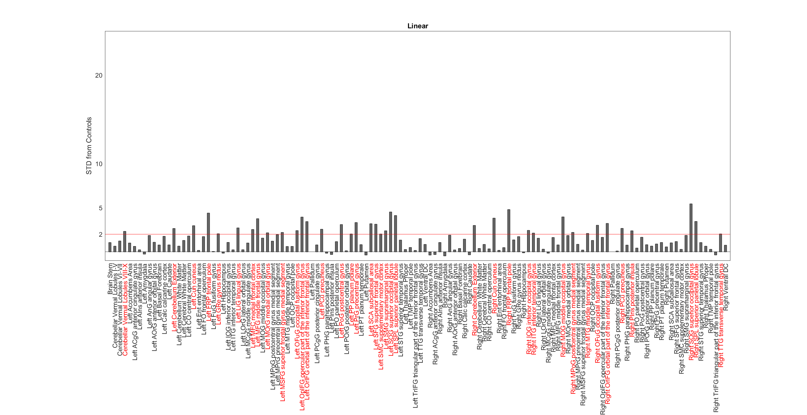
GG_2211

Slide 18
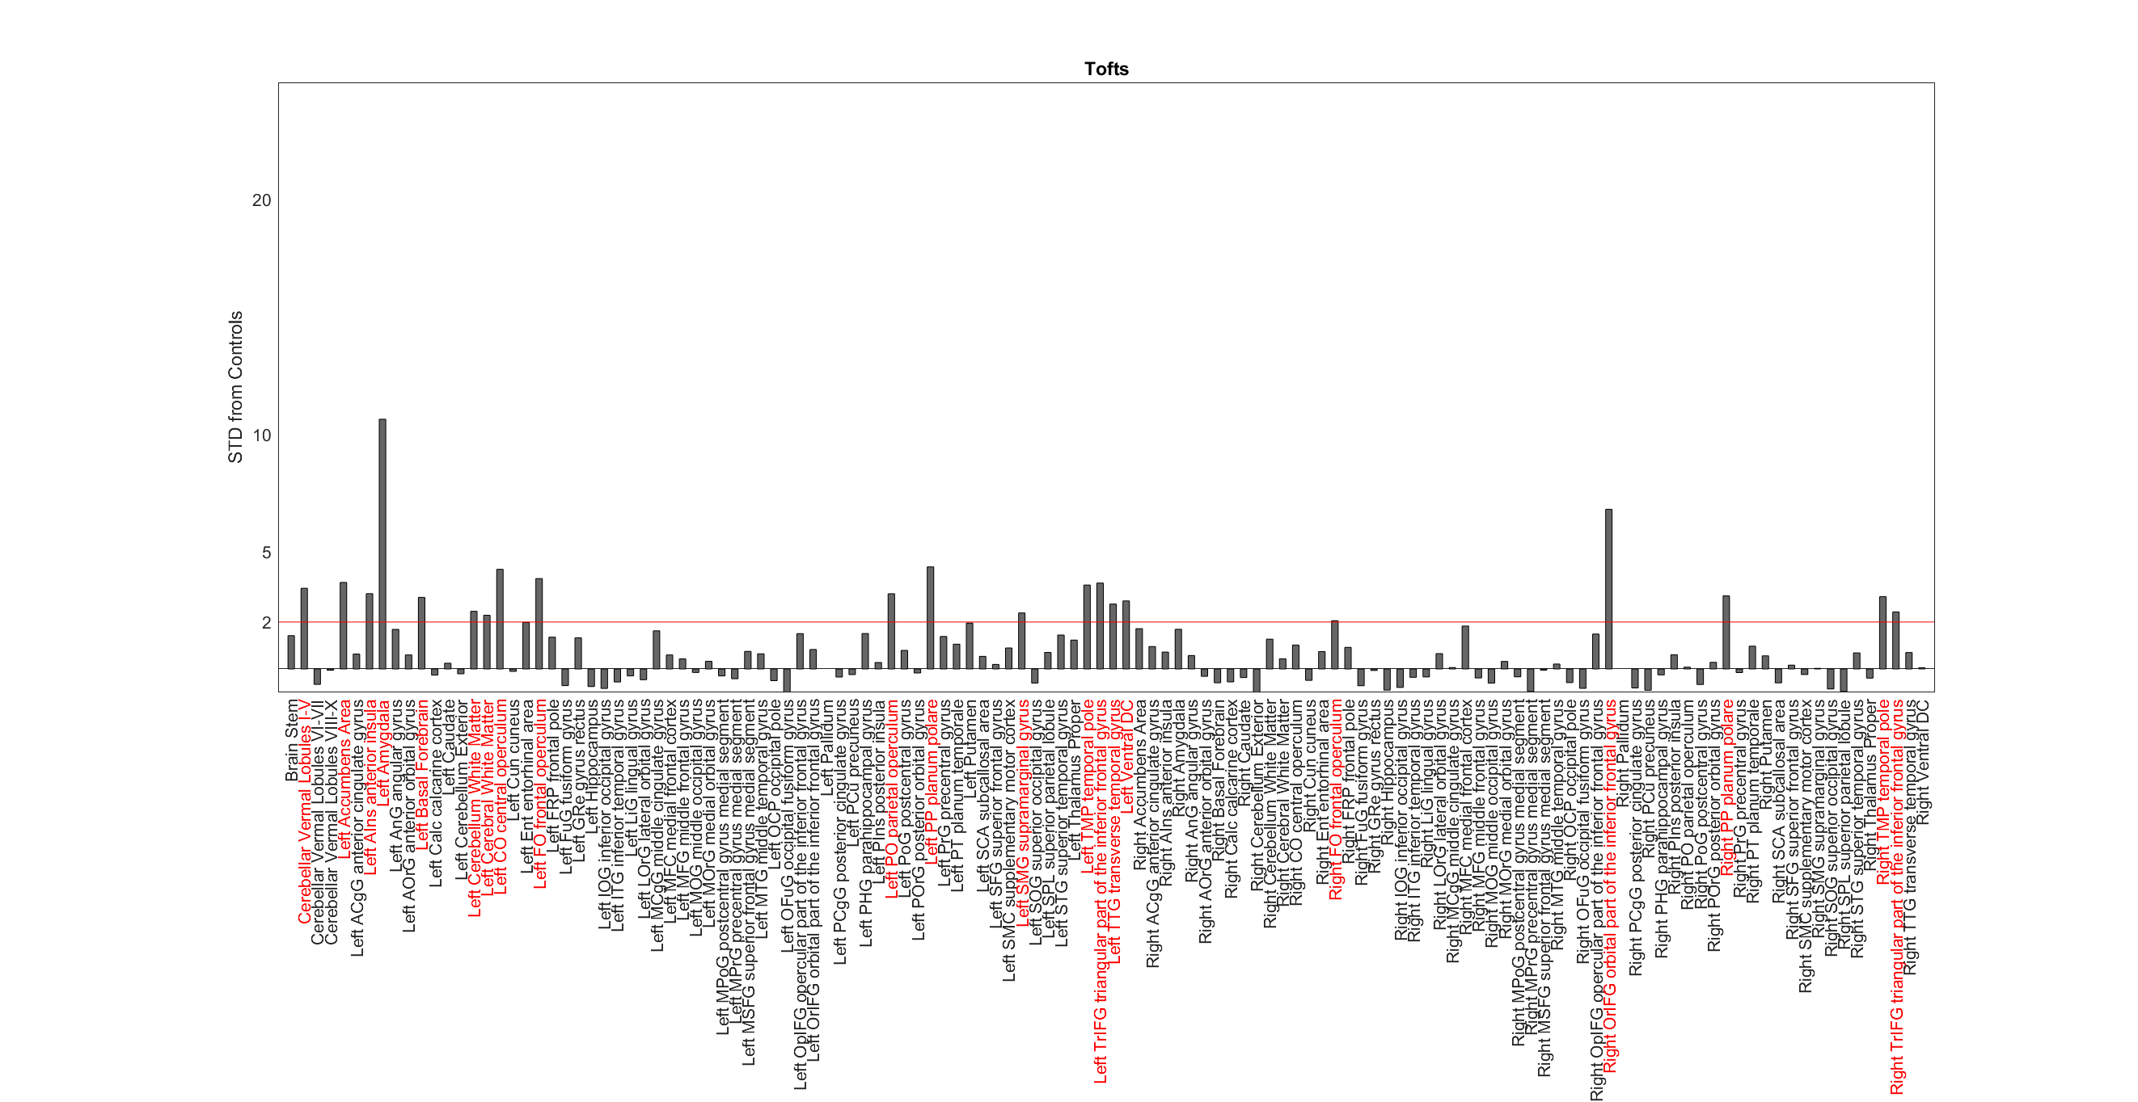
GG_2211

Slide 19
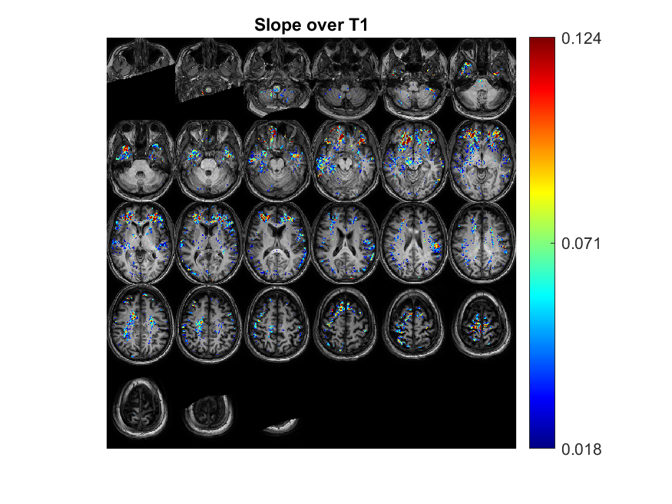
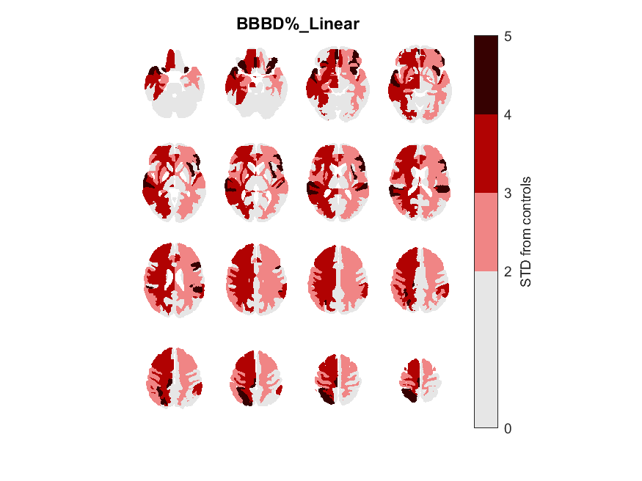
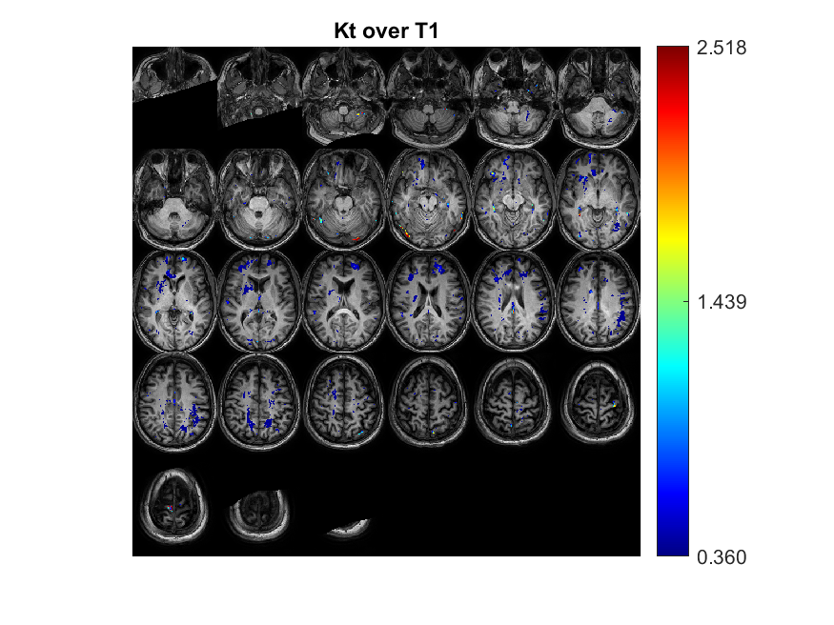

HY_9719
Focal/General | Focal Type | 'age' | 'gender' | 'Epilepsy type' | 'Seizures type' | 'Medications' | Depalept | Tegretol | Keppra | Lamictal | Family History | Age of oneset | Year of epilepsy | Sizure Frequency (/m) | Number of medication | Lesion_info | Lesion_info_en | Lesion | EEG_findings | EEG | Data source | Clinical files exist | EEG files exist
F | F | 44 | 'M' | 'Multi focal epilepsy possible left frontal' | 'Aura with out of focus experience (temporal?); then lefty hand dystonic. Then GTCS' | Briviact ' Gabapentin Trileptin | 0 | 0 | 0 | 0 | 0 | 14 | 30 | 1 | 0 | בסיס פרונטלי משמאל איזור מלציה | A frontal base to the left of the Malmation area | LF | frontal temporal right (and left) | RF RT |  | 1

Slide 20
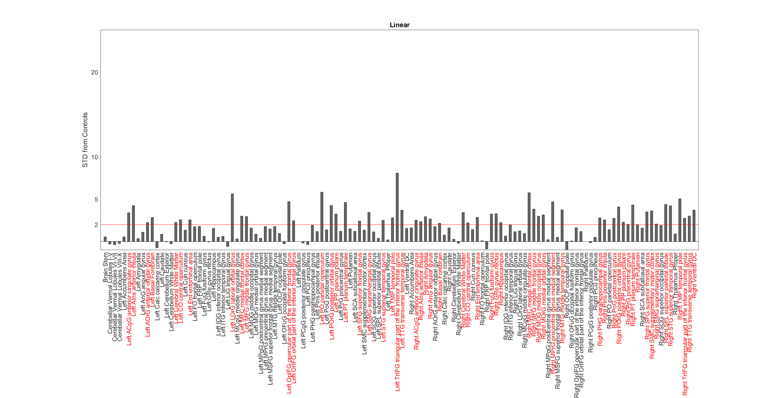
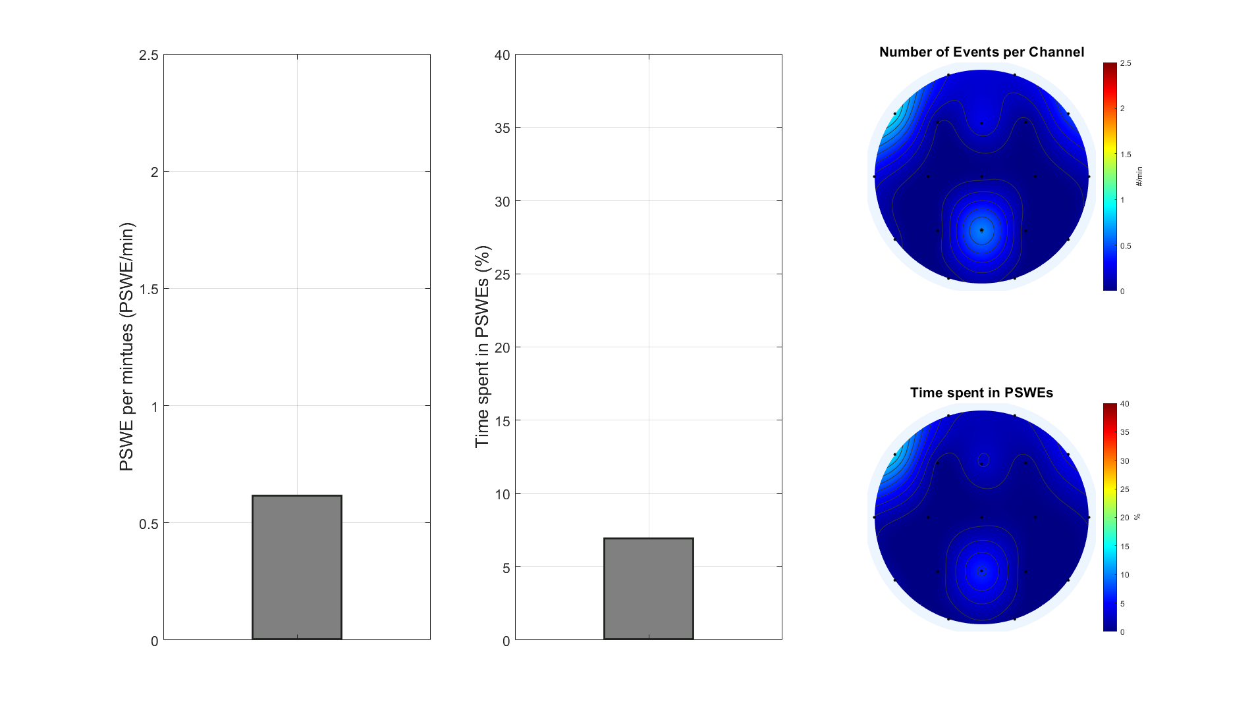
HY_9719

Slide 21
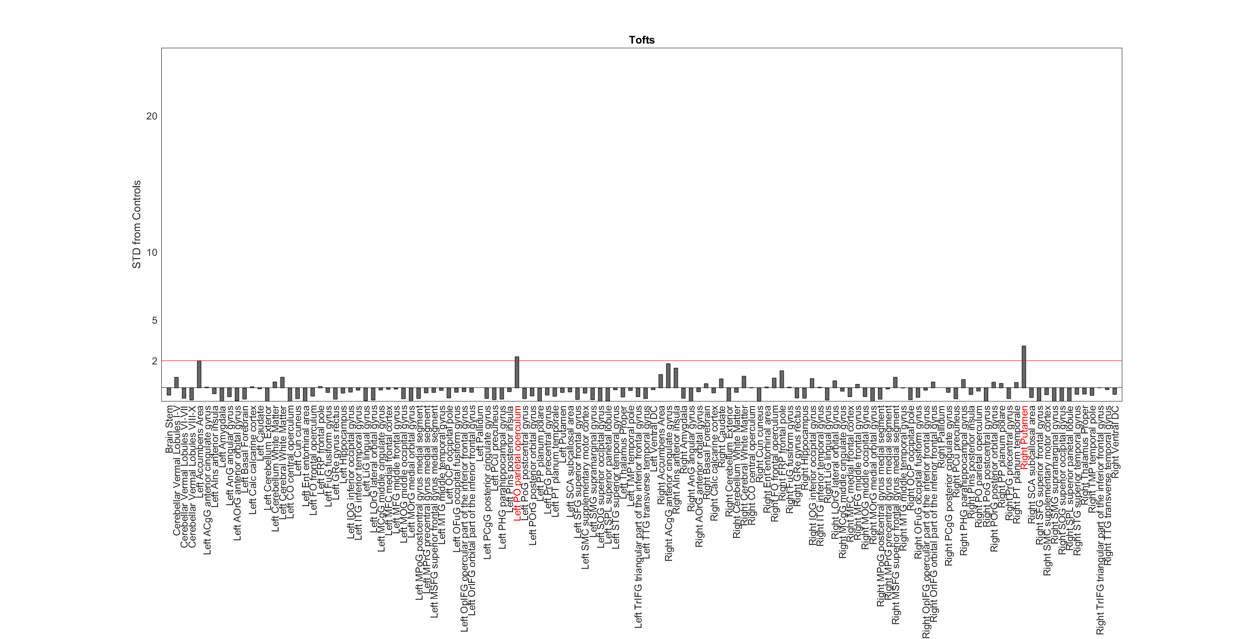
HY_9719

Slide 22
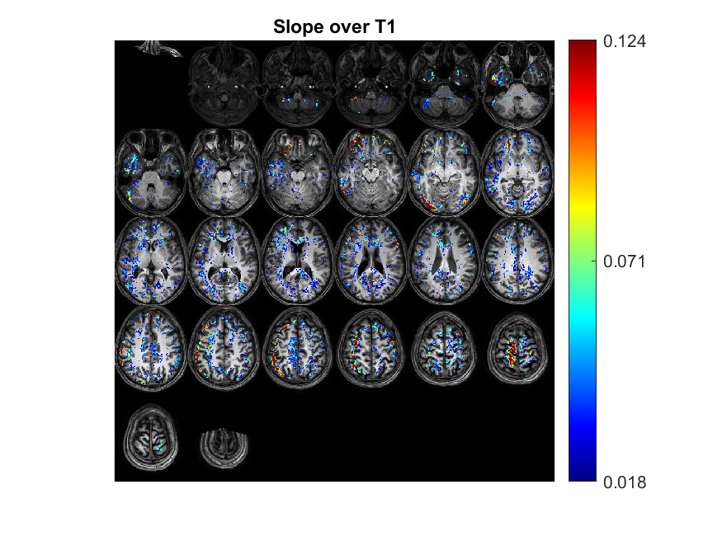
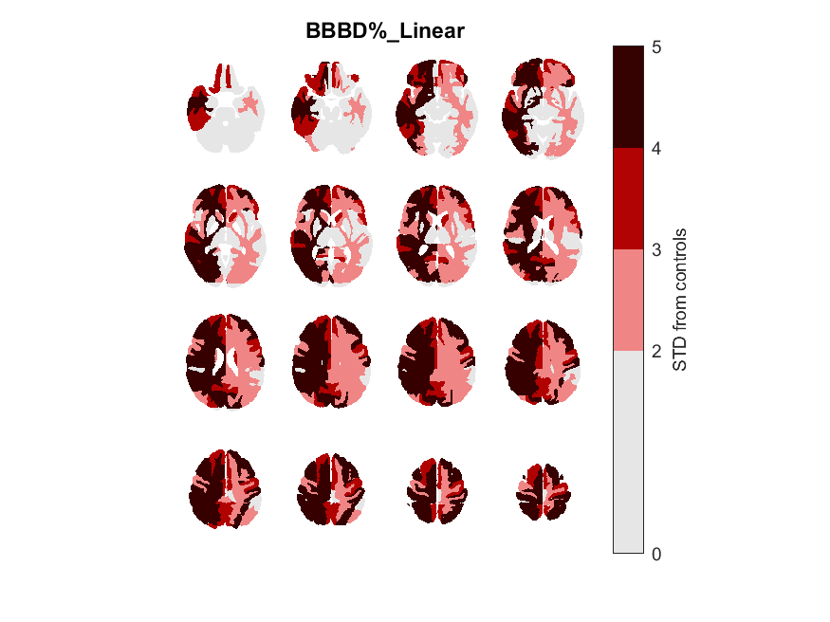
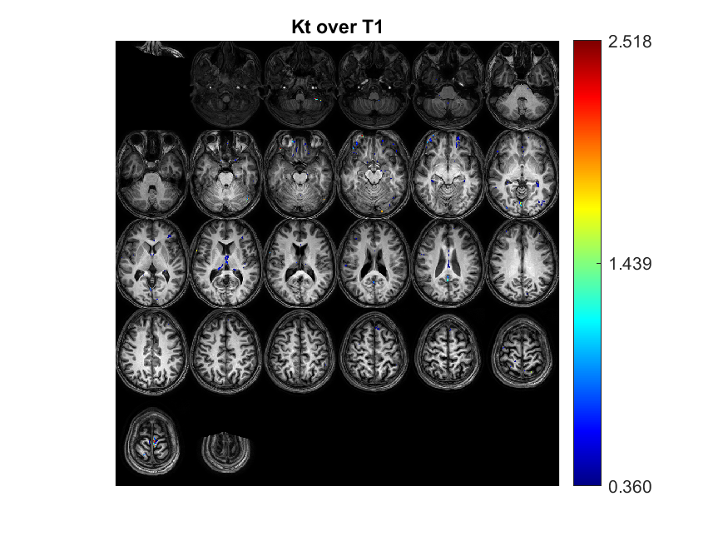

IE_2899
Focal/General | Focal Type | 'age' | 'gender' | 'Epilepsy type' | 'Seizures type' | 'Medications' | Depalept | Tegretol | Keppra | Lamictal | Family History | Age of oneset | Year of epilepsy | Sizure Frequency (/m) | Number of medication | Lesion_info | Lesion_info_en | Lesion | EEG_findings | EEG | Data source | Clinical files exist | EEG files exist
F | F | 29 | 'F' | Suspected focal epilepsy­for investigation |  | ESTROFEM LORIVAN/Lorazepam HYDROCORTISONE DUPHASTON SYNTHROID | 0 | 0 | 0 | 0 |  | 12 | 17 | 1 | 0 | מוקד המוסידרין זעיר אוקסיפיטאלי משמאל. חשיבות בספק | The focus of an oxypital cedarine is on the left. Importance in doubt | 0 | normal | 0 |  | 1

Slide 23
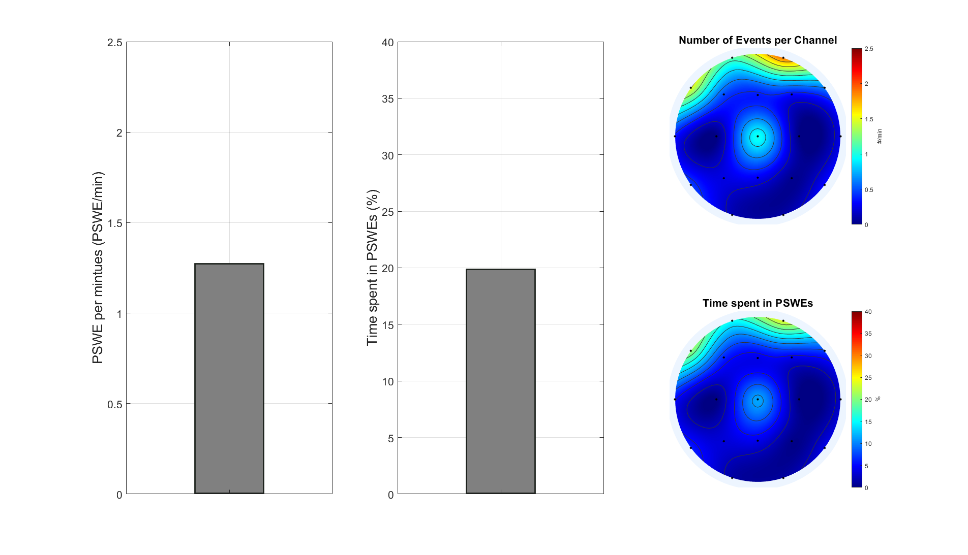
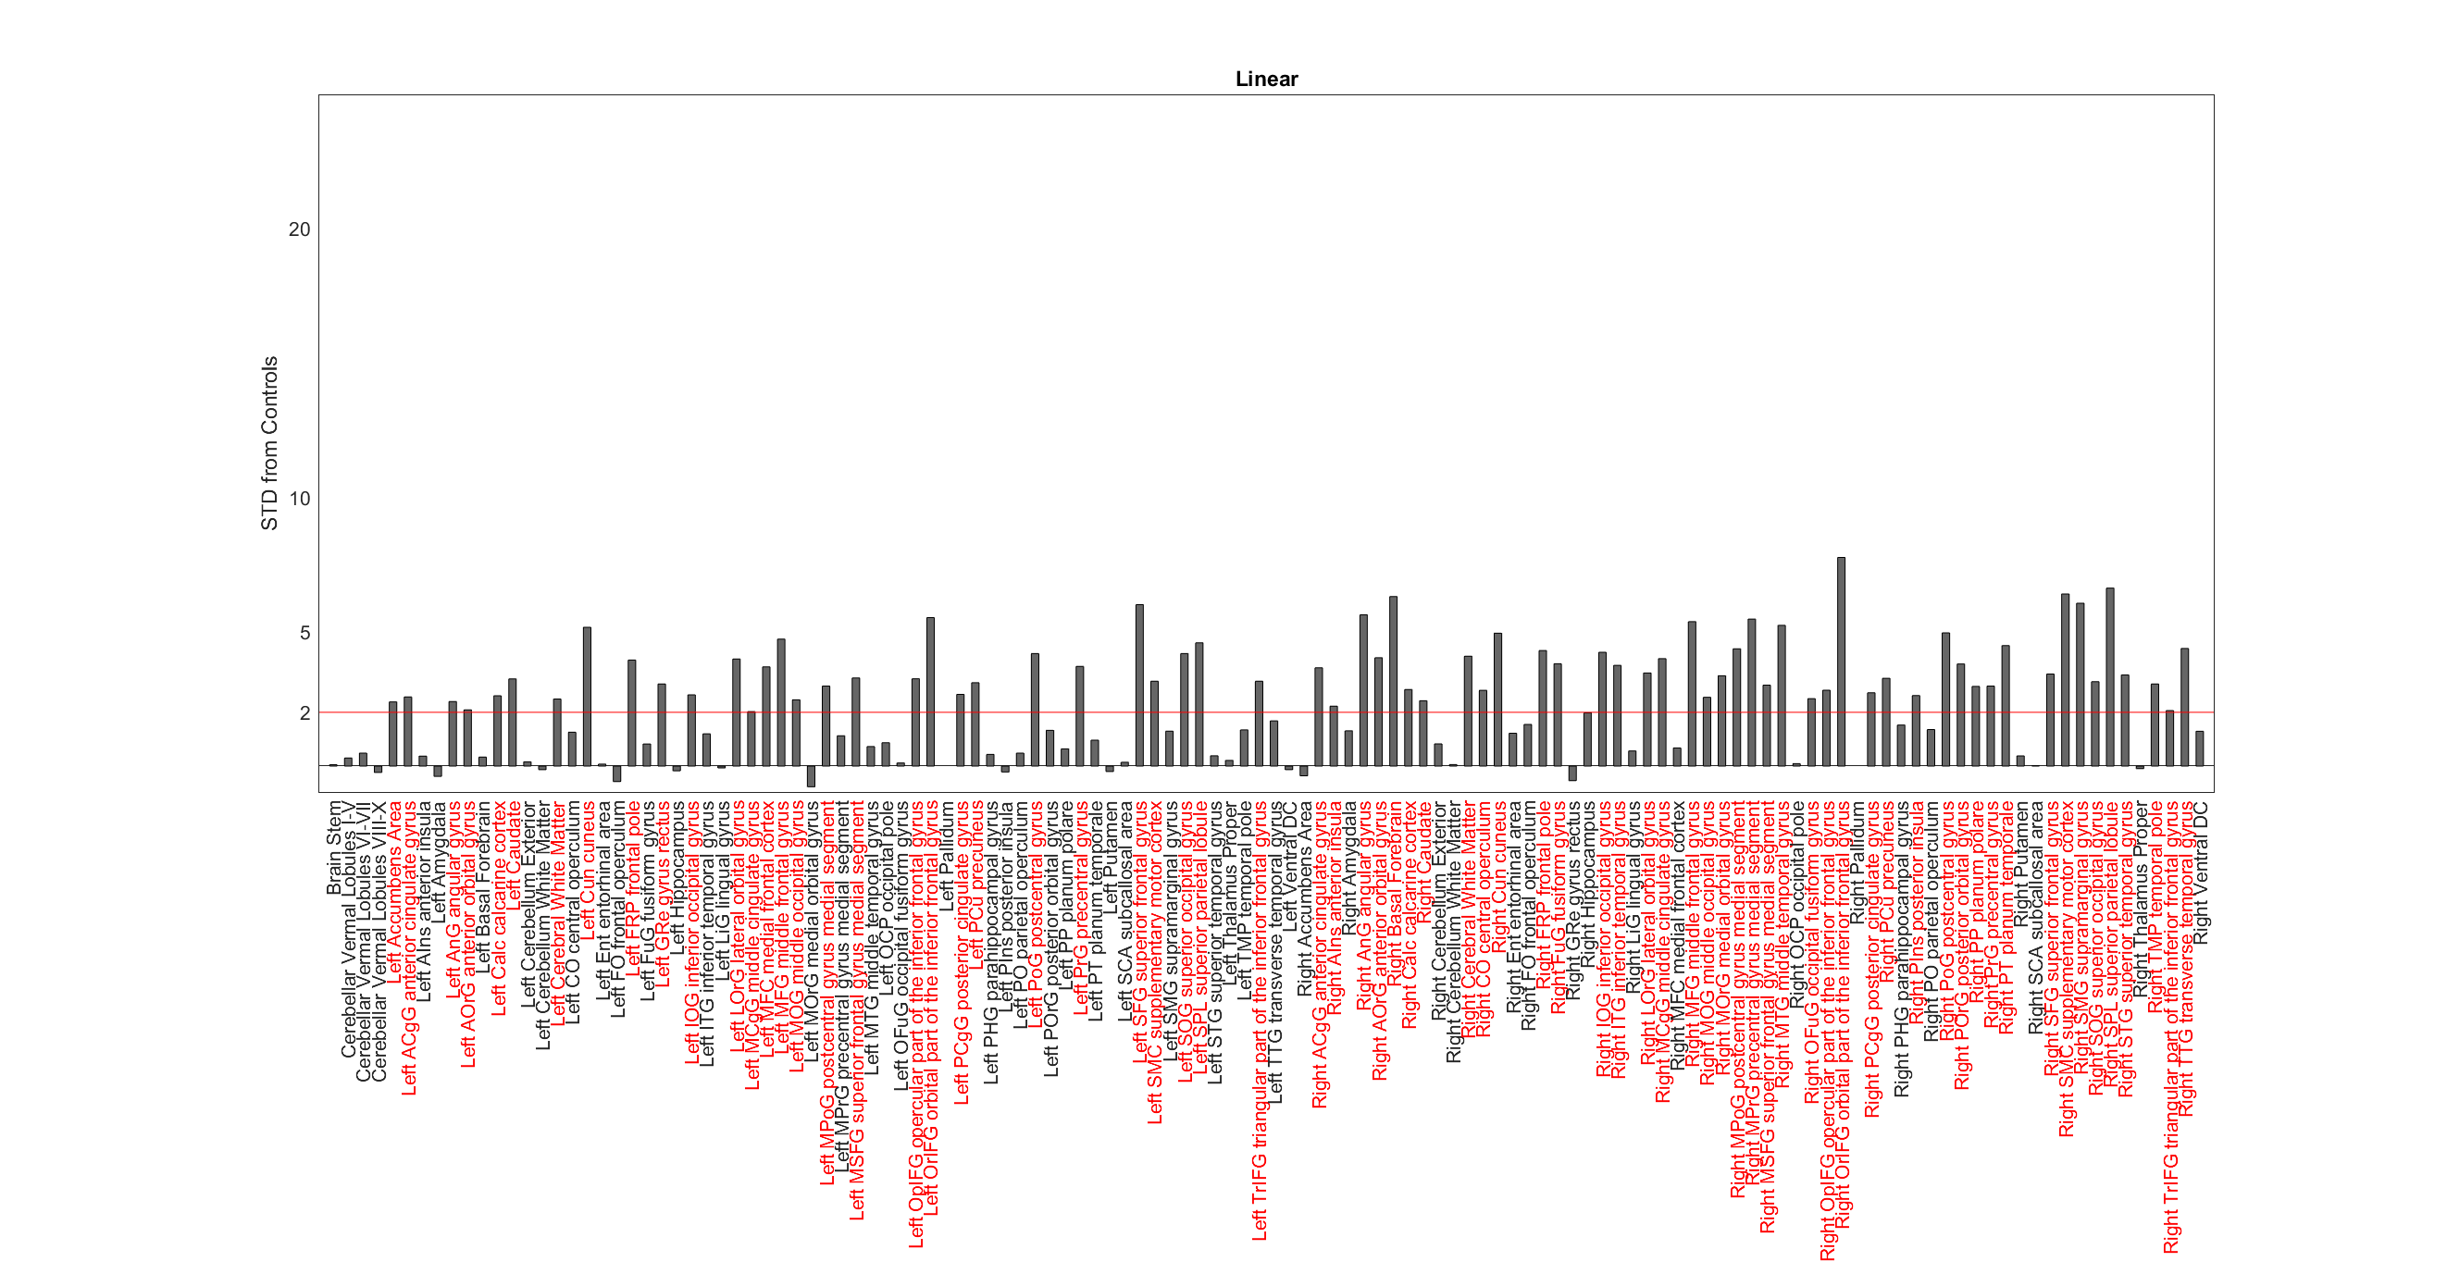
IE_2899

Slide 24
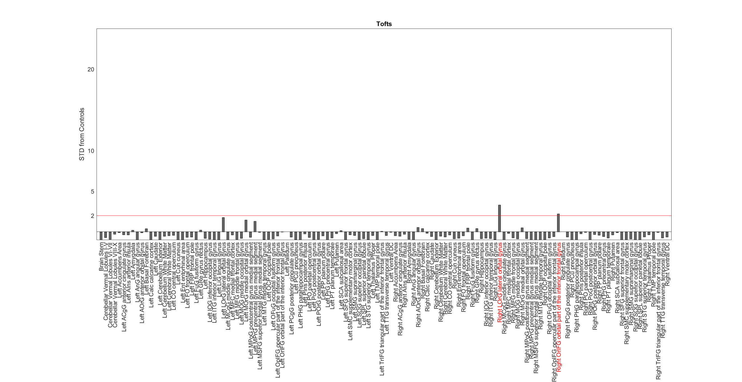
IE_2899

Slide 25
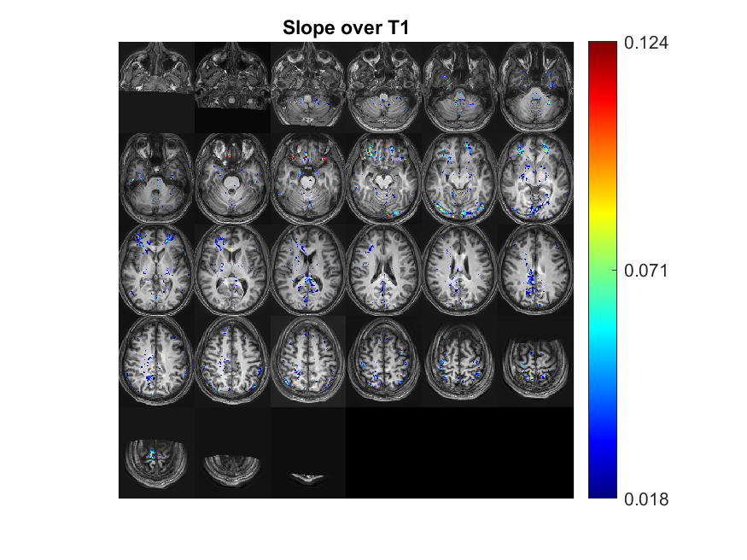



MB_1437
Focal/General | Focal Type | 'age' | 'gender' | 'Epilepsy type' | 'Seizures type' | 'Medications' | Depalept | Tegretol | Keppra | Lamictal | Family History | Age of oneset | Year of epilepsy | Sizure Frequency (/m) | Number of medication | Lesion_info | Lesion_info_en | Lesion | EEG_findings | EEG | Data source | Clinical files exist | EEG files exist
F | T | 31 | 'F' | 'Lt. TLE' | 'Rt. Upper limb and mouth with secondary generalization' | Tegretol , Valproic acid' | 0 | 1 | 0 | 0 |  | 10 | 21 | 4 | 1 | ציסטה בהיפוקמפוס. היפוקמפוס ימני דיספלסטי | Hippocampus cyst. Hypec and Dysplastic Hypacamos | LH | temporal right | RT |  | 1

Slide 26


MB_1437

Slide 27

MB_1437

Slide 28




ME_4933
Focal/General | Focal Type | 'age' | 'gender' | 'Epilepsy type' | 'Seizures type' | 'Medications' | Depalept | Tegretol | Keppra | Lamictal | Family History | Age of oneset | Year of epilepsy | Sizure Frequency (/m) | Number of medication | Lesion_info | Lesion_info_en | Lesion | EEG_findings | EEG | Data source | Clinical files exist | EEG files exist
F | T | 25 | 'M' | epieleptic focus T5' | NaN | ' Keppra Trileptin' | 0 | 0 | 1 | 0 |  | 17 | 8 | 4 | 1 | שינויים פוסט ניתוח להסרת קוורנומה פריאטלית משמאל | Post Changes Surgery to Removal Periatlite Quranoma to the Left | LP | frontal left | LF |  | 1

Slide 29


ME_4933

Slide 30

ME_4933

Slide 31





MH_4108
Focal/General | Focal Type | 'age' | 'gender' | 'Epilepsy type' | 'Seizures type' | 'Medications' | Depalept | Tegretol | Keppra | Lamictal | Family History | Age of oneset | Year of epilepsy | Sizure Frequency (/m) | Number of medication | Lesion_info | Lesion_info_en | Lesion | EEG_findings | EEG | Data source | Clinical files exist | EEG files exist
F | F | 35 | 'M' | Epilepsy(345.1) ' Left Frontal Cavernoma | 'Focal epilepsy with impaired awereness. Focal epilepsy with bilateral tonic' | None | 0 | 0 | 0 | 0 | 0 | 2 | 33 | 1.5 | 0 | LEFT MESIAL TEMPORAL SCLEROSIS | LEFT MESIAL TEMPORAL SCLEROSIS | LT | temporal | T |  | 1

Slide 32

MH_4108

Slide 33

MH_4108

Slide 34




PB_5115
Focal/General | Focal Type | 'age' | 'gender' | 'Epilepsy type' | 'Seizures type' | 'Medications' | Depalept | Tegretol | Keppra | Lamictal | Family History | Age of oneset | Year of epilepsy | Sizure Frequency (/m) | Number of medication | Lesion_info | Lesion_info_en | Lesion | EEG_findings | EEG | Data source | Clinical files exist | EEG files exist
F | F | 64 | 'M' | 'Focal epilepsy without impaired awareness' | Left Frontal Cavernoma 1/week' | 'Vimpat 50mg*2' | 0 | 0 | 0 | 1 |  | 63 | 1 |  | 1 | מוקדים מיקרואנגיופתיים – small vessel disease ככל הנראה חלקם קורטיקלים | Microngi -Vessese Disease Microng | 0 | פעילות אפילפטית אינטראיקטלית עם הדגשה פרונטלית עם הדגשה ימנית | RF | וולפסון, מרפאה נוירולוגית 31.05.2018 | 1

Slide 35


PB_5115

Slide 36

PB_5115

Slide 37




RS_7023
Focal/General | Focal Type | 'age' | 'gender' | 'Epilepsy type' | 'Seizures type' | 'Medications' | Depalept | Tegretol | Keppra | Lamictal | Family History | Age of oneset | Year of epilepsy | Sizure Frequency (/m) | Number of medication | Lesion_info | Lesion_info_en | Lesion | EEG_findings | EEG | Data source | Clinical files exist | EEG files exist
G |  | 20 | 'F' | JME | 'Focal without impaired awareness' | 'Lamictal ' | 0 | 0 | 0 | 1 | 1 | 3 | 17 |  | 1 | תהליך טמפוראלי מימין מסוייד בקוטר כ-1 ס"מ סמוך ל-OCCIPITAL TEMPORAL SULCUS - קוורנומה right | Temortal process to the right of 1 cm in diameter near the OCCPIPITAL TEMPORAL SULCUS-Quranoma RIGHT | RT | generalized. Frontal right | RF |  | 1

Slide 38

RS_7023

Slide 39

RS_7023

Slide 40




TA_4648
Focal/General | Focal Type | 'age' | 'gender' | 'Epilepsy type' | 'Seizures type' | 'Medications' | Depalept | Tegretol | Keppra | Lamictal | Family History | Age of oneset | Year of epilepsy | Sizure Frequency (/m) | Number of medication | Lesion_info | Lesion_info_en | Lesion | EEG_findings | EEG | Data source | Clinical files exist | EEG files exist
F | F | 51 | 'F' | Epilepsy' Frontal lobe Epilepsy | 'Seizure with impaired awereness and bilateral spead' | VIMPAT 200מ"ג TEGRETOL 300+600' | 0 | 1 | 0 | 0 |  | 20 | 31 | 8 | 1 | שינויים גליוטים/אנצפלומלציה פריאטלית גבוה מימין לאחר כריתה של AVM שדימם | Gluts changes/high -level enflums to the right after a resection of AVM that bleeds | RP | frontal temporal right | RF RT |  | 1

Slide 41


TA_4648

Slide 42

TA_4648

Slide 43



VA_6538
Focal/General | Focal Type | 'age' | 'gender' | 'Epilepsy type' | 'Seizures type' | 'Medications' | Depalept | Tegretol | Keppra | Lamictal | Family History | Age of oneset | Year of epilepsy | Sizure Frequency (/m) | Number of medication | Lesion_info | Lesion_info_en | Lesion | EEG_findings | EEG | Data source | Clinical files exist | EEG files exist
F | T | 23 | 'M' | Epilepsy(345.9) focal seizure with impaired awereness and focal to bilateral tonic clonic spread. Temporal Lobe Epilepsy | Pharmaco resistant epilepsy | Depalept CR 750 mg 1/D tegretol 600 mg 2/D Keppra 1500 mg 2/D | 1 | 1 | 1 | 0 | 0 | 6 | 17 | 0.5 | 3 | מוקד גליוטי ישן קורטיקלי אוקסיפיטאלי מימין. MTS מימין | The Oxipital Cortical Cortical Cortical focus on the right. Mts to the right | RO | temporal occipital right | RT RO |  | 1

Slide 44


VA_6538

Slide 45

VA_6538

Slide 46
Scans without lesion

Slide 47



AB_1866

Slide 48


AB_1866

Slide 49

AB_1866

Slide 50




AE_2898

Slide 51


AE_2898

Slide 52

AE_2898

Slide 53



BN_5397

Slide 54


BN_5397

Slide 55

BN_5397

Slide 56




DB_5942

Slide 57

DB_5942

Slide 58

DB_5942

Slide 59




DJ_5694

Slide 60

DJ_5694

Slide 61

DJ_5694

Slide 62




DM_9307

Slide 63

DM_9307

Slide 64

DM_9307

Slide 65




DN_8054

Slide 66

DN_8054

Slide 67

DN_8054

Slide 68




GD_0671

Slide 69

GD_0671

Slide 70

GD_0671

Slide 71




GN_9876

Slide 72

GN_9876

Slide 73

GN_9876

Slide 74




HS_4511

Slide 75

HS_4511

Slide 76

HS_4511

Slide 77




IR_5953

Slide 78


IR_5953

Slide 79

IR_5953

Slide 80




LL_0265

Slide 81

LL_0265

Slide 82

LL_0265

Slide 83




LY_2476

Slide 84

LY_2476

Slide 85

LY_2476

Slide 86




SB_9785

Slide 87


SB_9785

Slide 88

SB_9785

Slide 89




SH_1959

Slide 90

SH_1959

Slide 91

SH_1959

Slide 92




WS_7206

Slide 93

WS_7206

Slide 94

WS_7206

